Slide 1


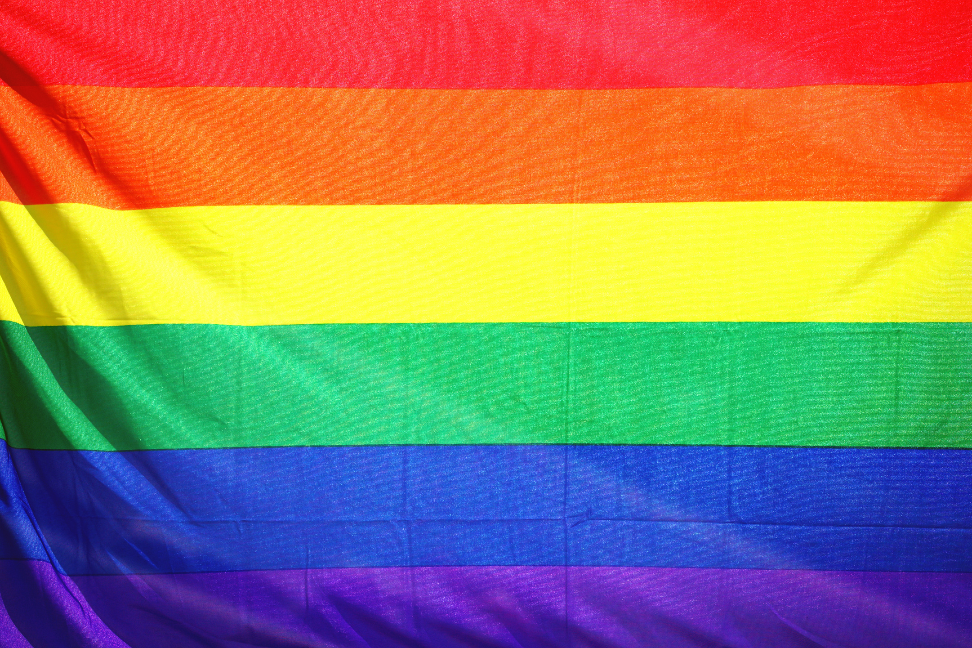
11 FURTHER LGBTQ+ Facts From AR History
Notes:
Did you know that the CALS EOA has many entries on LGBTQ+ issues, celebrities, laws, books, and more?

Slide 2
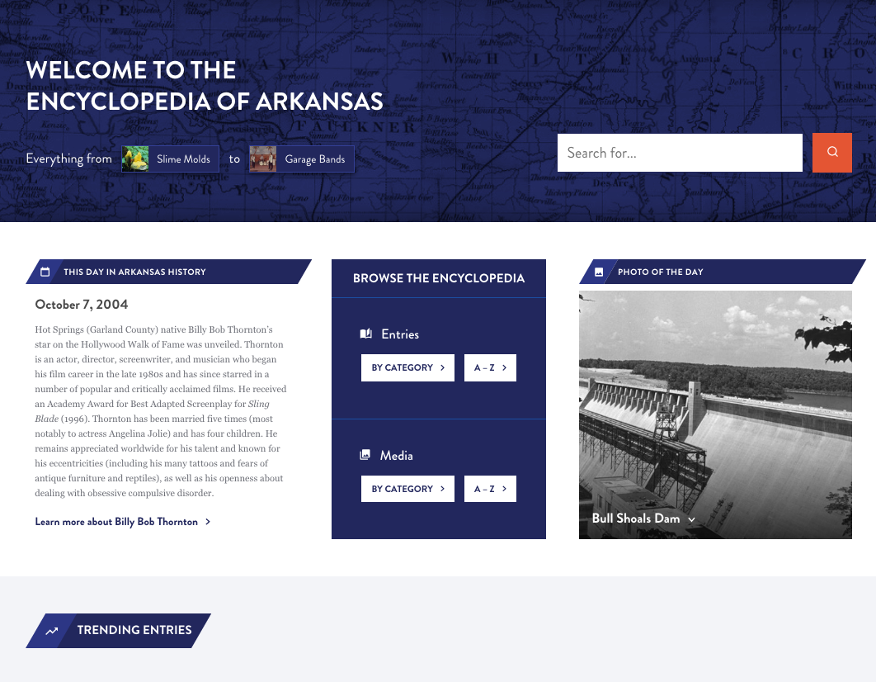
Notes:
The Encyclopedia of Arkansas launched in 2006 with 700 entries and 900 pieces of media.
In 2019 we switched platforms from the original proprietary site to a newly designed WordPress site.
And then in August 2022 we undertook a further redesign of the homepage, search function, and user experience features.
You can stop by the EOA for tidbits like THIS DAY IN ARKANSAS HISTORY and PHOTO OF THE DAY...
As well as trending entries and or to see what's been newly updated. (And here's a hint, we are updating all the time.)

Slide 3
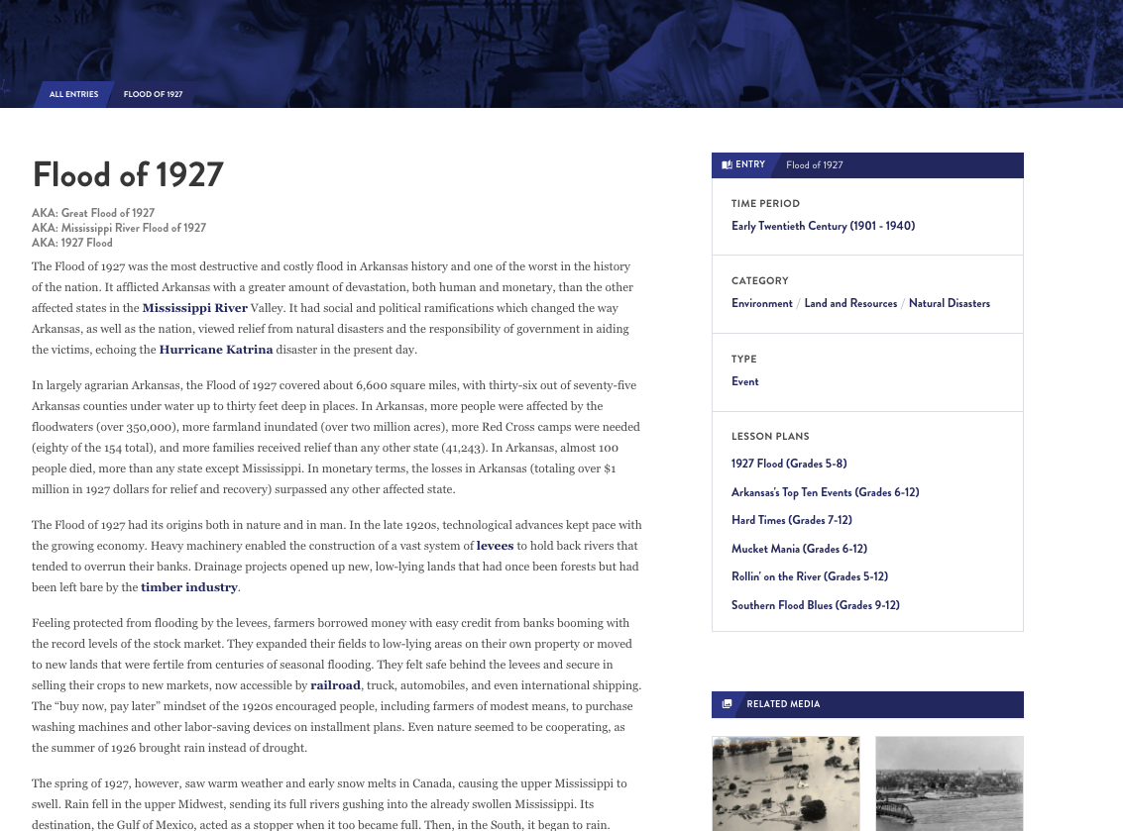
≈7,600
entries
Notes:
We currently have about 7,600 entries online.
We are often compared to Wikipedia but we are not crowd-edited.
All our content is peer-reviewed and staff edited. That means you can use the CALS EOA knowing it has the same accuracy and legitimacy as a published book or article.
Anyone can write for the EOA but all entries are reviewed by other scholars, fact checked, and edited for grammar and spelling.

Slide 4
  EVERY incorporated community
  Government officials
  Civil rights organizations from NAACP to CLOB
  EVERY military action including the smallest skirmishes
  Wildlife, flowers, plants
Notes:
WE HAVE ENTRIES ON ...
Every incorporated community and hundreds of unincorporated ones, and are always seeking more.
ENTRIES ON
Government officials, from those who served in Congress, to Arkansas constitutional officers, to individual state legislators, and even significant sheriffs, mayors, and county judges.
Civil rights organizations from the national level, such as the NAACP, to the local level, such as CLOB (Council for Liberation of Blacks).
Military events from the Civil War, ranging from major battles (Pea Ridge) down to small local skirmishes; if someone in blue and someone in gray met in the woods between 1861 and 1865 we probably have an entry documenting it.
AND THE NATURAL ENVIRONMENT - birds, fish, mammals, reptiles, and insects but also fungi, lichens, ferns, jellyfishes, slime molds YOU NAME IT!
AND WE ARE ALWAYS DEVELOPING MORE...
Developing entries on every film set or filmed in Arkansas, as well as every book, television show, and even individual episodes set in the state (Search: X-Files).

Slide 5
Produced by a public library
Users in 230 countries
EVERY continent
Notes:
We are unique in that we are produced by a public library.
Our site is used by government agencies and officials, students, media, genealogists, journalists, historians (local and national).
Users have come from every continent (including Antarctica) and more than 230 countries.
Last year we averaged approximately 166,000 users per month.

Slide 6
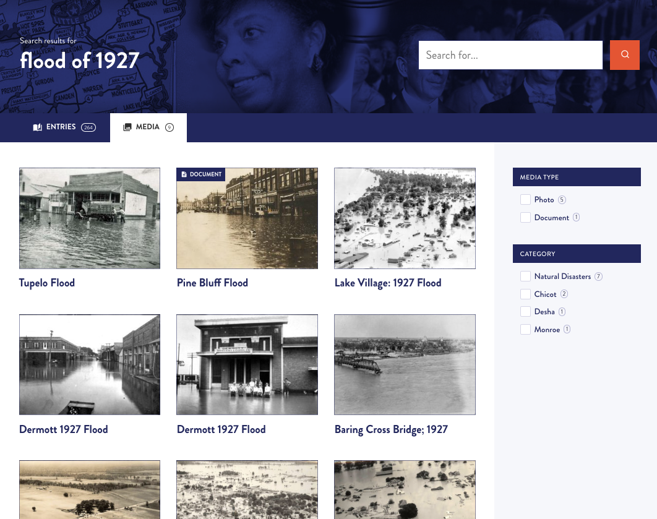
≈17,000
media
Notes:
AND BOY DO WE HAVE MEDIA...
We currently have about 17,000 pieces of media published on the site.
We have worked with archives, libraries, museums, and universities around the state and the country to make sure that the EOA has visual images to illustrate our entries.
BUT THERE IS ALWAYS MORE TO FIND...
We accept submissions from everyday citizens of any photos you've taken we can pair with an entry. For example we love photos of water towers from small towns.

Slide 7
11 FURTHER LGBTQ+ Facts From AR History

Slide 8
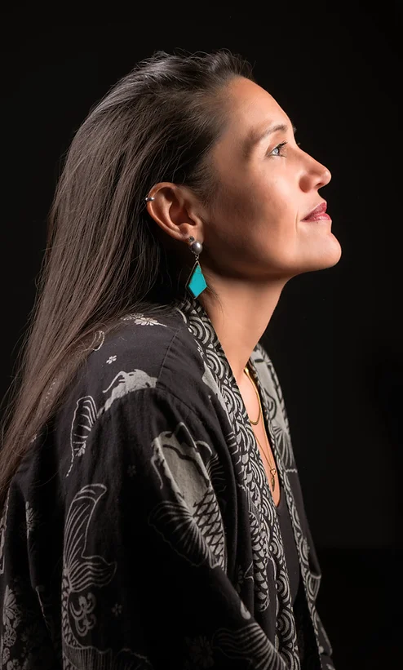
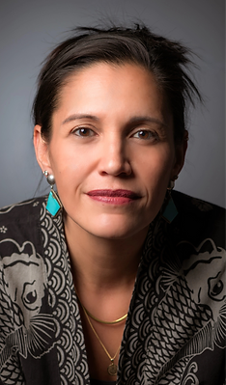
Notes:
Kai Coggin (1980–) is a gay, Filipina-American poet, teacher, photographer, and certified master naturalist. She is the inaugural Poet Laureate of Hot Springs (Garland County) and the community leader in charge of hosting the longest running open mic poetry night in the nation, Wednesday Night Poetry (WNP). To date, she has published five books of poetry.
Kai Coggin was born Kimberley Katherine Coggin in 1980. She grew up in the southwestern Houston suburb of Alief, Texas. Coggin entered Texas A&M University in College Station as a premed major in 1998. She was a member of the student military Corp of Cadets and a drummer in the marching band. Coggin experienced traumatic hazing. She was eventually kicked out of the Corps for violating the “Don’t Ask Don’t Tell” policy when she fell in love with another female cadet. Coggin remained at the school, changing majors to English creative writing. She obtained a Bachelor of Arts in Poetry and Creative Writing in 2004.
After only five years of teaching (2003–2008), she was recognized as Teacher of the Year and District Secondary Teacher of the Year and was a top five finalist for Regional Teacher of the Year out of 85,000 teachers. When a school project culminated in a visit for herself and her students with famous writer Sandra Cisneros, Coggin decided to leave teaching to pursue her dream of writing poetry.
In 2008, Coggin met the woman who would become her wife, painter and master naturalist Joann Saraydarian, and selected the new name Kai as part of a spiritual rebirth. In 2012, Coggin and her partner moved from Houston to Arkansas. Coggin started attending WNP in 2013, and Bud Kenny, WNP’s founder, became a mentor to her. On February 6, 2019, the series’ thirtieth anniversary, Kenny made Coggin the new official host.

Slide 9


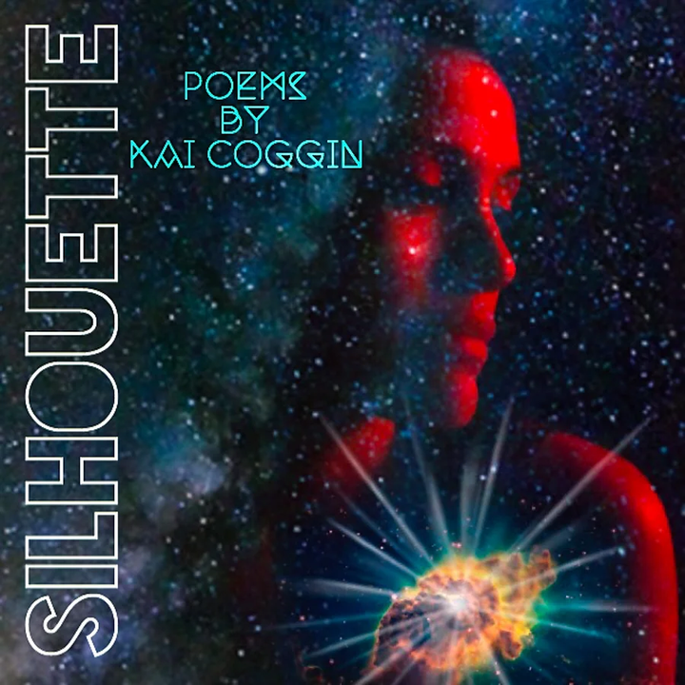
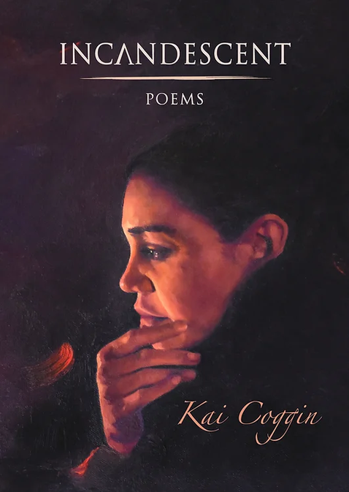

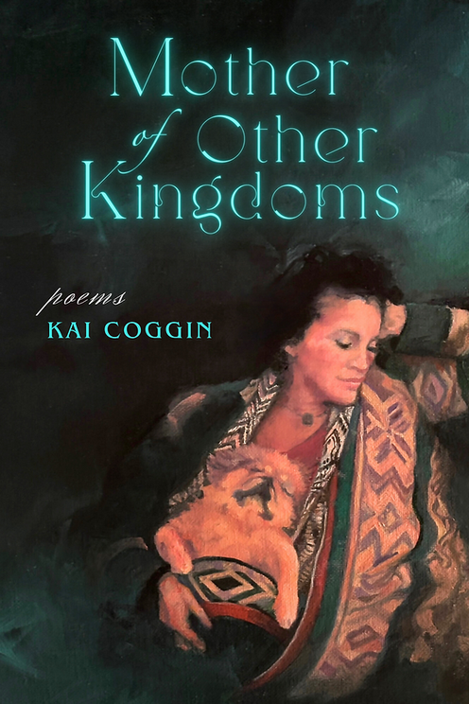
Notes:
Coggin has been published in a variety of print and online journals, as well as various anthologies. Coggin’s publications include five books of poetry and one poetry album: Periscope Heart (2014); Wingspan (2016); debut spoken world album Silhouette (2017); Incandescent, published with local Little Rock (Pulaski County) LGBTQ+ publisher Sibling Rivalry Press (2019); Mining for Stardust (2021); and Mother of Other Kingdoms (2024). Except for the NASA photograph featured on the cover of her fourth book, all of Coggin’s book covers were painted by her spouse.
On February 1, 2023, Pat McCabe, mayor of Hot Springs, appointed Coggin the very first Poet Laureate for the City of Hot Springs.
In 2024, she was awarded a $50,000 fellowship from the American Academy of Poets for a project called Sharing Tree Space, aimed at connecting groups of teenagers with the natural world.

Slide 10
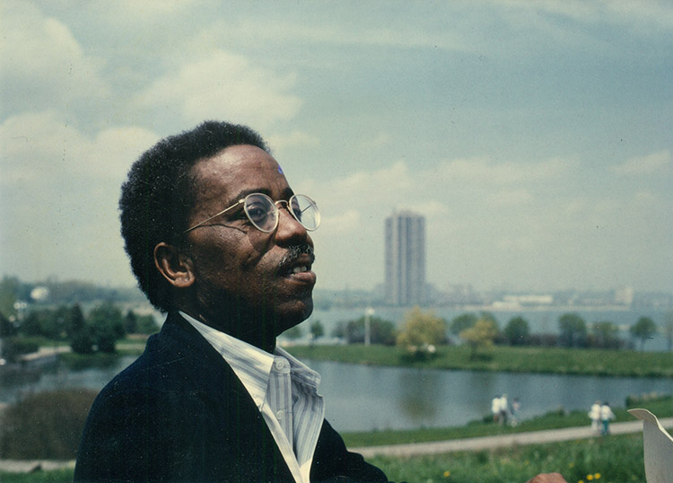
Notes:
Herbert Denton Jr. (1943–1989) was a leading African-American journalist at the Washington Post. Raised in Little Rock (Pulaski County), the son of a prominent public educator, Denton became the first person of color to hold a supervisory position at the Post. During his career, Denton reported for the metro, national, and foreign desks; served as both Maryland and District editor; hired and mentored a generation of minority journalists (especially African Americans and women); and built a potent legacy of journalistic excellence at the Washington Post.
Herbert H. Denton Jr. was born in 1943 in Indiana. He spent part of his infancy in Arkadelphia (Clark County), his mother’s hometown, and was living in Little Rock by age two. Denton attended Gibbs Elementary and Dunbar Junior High. He was raised in the church at Mount Pleasant Missionary Baptist.
When the Central High desegregation crisis began in 1957, Denton was in the ninth grade at Dunbar, just one grade below the youngest members of the Little Rock Nine. He knew many members of the Nine personally; Ernest Green lived two blocks away from him. During the Lost Year of 1958–59, Denton attended high school in Hot Springs (Garland County). There, a teacher recommended him for a summer program at Howard University in Washington DC.
At the summer program, Denton met another Black student who was enrolled at the Windsor Mountain School. Denton was able to gain admission with a full scholarship. He graduated as valedictorian of the Windsor Mountain class of 1961 and was admitted to Harvard University. He majored in American history and spent a good deal of his time working at the Harvard Crimson.
Denton graduated from Harvard in 1965 and went to work for J. P. Morgan in New York City but quickly changed paths. For about one-fifth of what he was making as a banker, Denton moved to Washington and began co-editing a magazine called The American Student with his best friend from Harvard, Hendrik Hertzberg.

Slide 11
Notes:
Denton began his career at the Washington Post as a summer intern in 1966. He was drafted into the military that August. After basic training Denton spent one year as a public information specialist in Vietnam. He earned a Bronze Star for Valor.
Denton returned in 1968 and began covering education issues, especially those that affected African-American students. He reported on the Maryland controversies of desegregation and busing. In 1974, he was named Maryland editor. This marked the first time in the newspaper’s history that a non-white journalist was given command of a section of the newsroom.
In 1976 in DC, Denton was named the paper’s city editor. Again, he was the first person of color to occupy this position. As city editor, Denton oversaw coverage of all politics and culture in DC, most notably the 1978 mayoral election that gave Marion Barry the first of his four terms in that office.
In 1980, Denton started reporting for the Post’s prestigious national staff. He covered the early years of the Reagan White House, as well as major stories across the United States. He also published occasional analysis and opinion pieces, for both the Post and other publications, including a major reflection on the twenty-fifth anniversary of Central’s desegregation.
In 1982, Denton transitioned to the foreign desk. He was dispatched to Beirut, where he covered the Lebanese civil war.
In the latter half of 1984, Denton fell gravely ill and was evacuated from Beirut. In March, he returned to the Middle East to cover the Iran-Iraq War. This assignment only lasted a month, however, as Denton fell ill again.
In June 1985, Denton took what would become his final assignment: bureau chief (and sole correspondent) for the Washington Post in Canada, a position that had not existed until then. For almost four years, Denton was based in Toronto and covered all aspects of Canadian politics and culture, from coast to coast. His deep and multifaceted coverage of the country earned him tremendous admiration from his journalistic peers in Canada.
Herbert Denton Jr. filed his last story, from Toronto, in 1989. He was suffering from a lethal case of pneumonia, abetted by full-blown AIDS. A host of friends and family members from Washington and Little Rock came to see him in these final days. The vast majority of them never knew that he was gay. Those who did were only able to guess so; he never revealed his sexuality except to a few friends in Canada. He was buried at Little Rock National Cemetery.

Slide 12

Notes:
The Gospel of Eureka
Eureka Springs (Carroll County) draws a large gay and lesbian community. The Metropolitan Community Church of the Living Springs performs commitment ceremonies for gay and lesbian couples. In 2007, the city council voted to create a registry of domestic partnerships, and in 2010 Eureka Springs became the only city in Arkansas to provide city employee health insurance coverage for domestic partners. Websites for the city promote its atmosphere of tolerance and mutual respect, but groups such as the American Family Association continue to protest the city’s acceptance of the gay and lesbian community. The 2018 documentary The Gospel of Eureka addressed the odd co-existence of both a gay nightlife and attractions for Christian fundamentalists in Eureka Springs.
The independent documentary The Gospel of Eureka (2018), directed by Michael Palmieri and Donal Mosher, attracted acclaim for its mix of natural beauty and genial small-town tolerance. The portrait of Eureka Springs (Carroll County) focuses on the Great Passion Play, the Eureka Live Underground gay bar, and the relaxed attitudes of the organizers and patrons of both those local attractions.
The filmmakers cleverly cut back and forth between two groups of enthusiastic local amateur performers: those working on the Passion Play and those appearing in the drag queen extravaganzas at the bar. Bar owners Lee Keating and Walter Burrell (a couple for thirty-one years, until Keating’s death in 2017) and Kent Butler, marketing director and star of the Passion Play (playing Jesus), are all friendly and tolerant of the others’ rights. Most of the drag queens consider themselves devout Christians, and most of the Evangelical Christians who speak in the film do not reject gays.
Mosher and Palmieri briefly note the darker history of Eureka Springs, spending a few minutes on Gerald L. K. Smith, the anti-Semitic founder of the Passion Play and maker of the Christ of the Ozarks statue (which is shown many times in the documentary, including in extreme close-up), and on Anita Bryant, an anti-gay crusader who attempted to put on her own religious show in Eureka Springs. Smith’s bigotry has been cut out of the play, and Bryant filed for bankruptcy in Arkansas after the failure of her show.
The documentary concludes by covering the 2015 referendum in which Eureka Springs voters approved a local ordinance banning discrimination against gays, by a vote of 579 to 231. It does not mention that the Arkansas General Assembly quickly overruled this local vote with the 2015 Intrastate Commerce Improvement Act, which forbade local protection for classes of people not protected by state law.
Variety (online March 13, 2018) called the “joyful” documentary a “cheerful small town portrait” and “an idealistic crowd-pleaser” with “a sharp eye for details.” New York Magazine (February 11, 2019) noted that “the easygoing tone of The Gospel of Eureka…distinguishes it from many other documentaries about timely social issues.” On the other hand, the New York Times (February 7, 2019) complained that the movie “refuses to grapple with its glaring contradictions” and accused the filmmakers of “favoring the superficial over the substantive.”
In a booklet issued with the Kino Lorber DVD, Caden Mark Gardner sums up the community’s contradictions as portrayed in the film: “The community joins in [gay] pride parades, they perform the Passion Play, go dancing to old gospel music alongside a shimmying drag queen, and still manage to go to church on Sundays.” The Gospel of Eureka was shown on POV, a PBS program, on June 24, 2019.

Slide 13

Notes:
Ed Madden (1963–) is a poet, activist, and educator who has written, co-written, and edited numerous books and anthologies. His poem “Sacrifice” was selected for the Best New Poets 2007 anthology. In 2015, he was named the first poet laureate of Columbia, South Carolina.
Ed Madden was born in 1963. Originally from Newport (Jackson County), Madden grew up on a rice farm. His family was devoutly Christian. Madden studied English and French at Harding University in Searcy (White County) and graduated with a BA in 1985. He received a BS in biblical studies from the Institute for Christian Studies in Austin, Texas, in 1992; an MA from the University of Texas (UT) at Austin in 1989, and a PhD in literature from UT in 1994. In his essay “An Open Letter to My Christian Friends,” which now appears in various textbooks, Madden recounts growing up in a conservative Church of Christ environment and working to suppress his own homosexuality before finally coming to terms with it.
Madden is a professor of English and director of women’s and gender studies at the University of South Carolina. His first poetry collection was Signals (2008), which won the 2007 South Carolina Poetry Book Prize. His second poetry collection, Prodigal: Variations, was published in 2011. He has also published chapbooks Nest (2010) and My Father’s House (2013), and full-length books Nest (2014) and Ark (2016). Madden often writes about his childhood in Arkansas as well as spirituality and equal rights. His essays on sexuality and spirituality also appear in various anthologies and publications.
Madden has published several critical articles and books on modern British and Irish poetry. He also co-edited an anthology of essays and poems on the male experience, "The Emergence of Man into the 21st Century" (2002).
Madden has received many awards and fellowships, as well as writer-in-residence appointments. He also won the State newspaper’s poetry contest.
Madden, who is known for his activism, regularly writes editorials on gay rights for local and national newspapers. He has served in many roles, including president, of the South Carolina Gay and Lesbian Pride Movement. Madden was the executive producer for Rainbow Radio: The REAL Gay Agenda, a talk show broadcast on Air America, and he compiled Out Loud: The Best of Rainbow Radio (2010). Out Loud was chosen by the University of South Carolina’s Upstate campus as a common reader for its first-year experience, a controversial move that led the South Carolina legislature to cut funds to the school. Madden’s activism also garnered a 2006 Legacy Award from the Human Rights Campaign of the Carolinas for “a consistent and significant record of working to improve the lives and visibility of LGBT people in North and South Carolina.” Madden gave a TEDx Talk in 2014 and has been featured on National Public Radio.
Madden lives in Columbia with his husband, Bert Easter, who is a past president of the South Carolina Gay and Lesbian Pride Movement. Both served as board members for the Harriet Hancock Community Center (formerly the South Carolina Gay and Lesbian Community Center). Madden and Easter were among the first gay couples to be legally married in the state. In 2023, he published "A Pooka in Arkansas," a collection of autobiographical poems about finding his identity and leaving Arkansas.

Slide 14
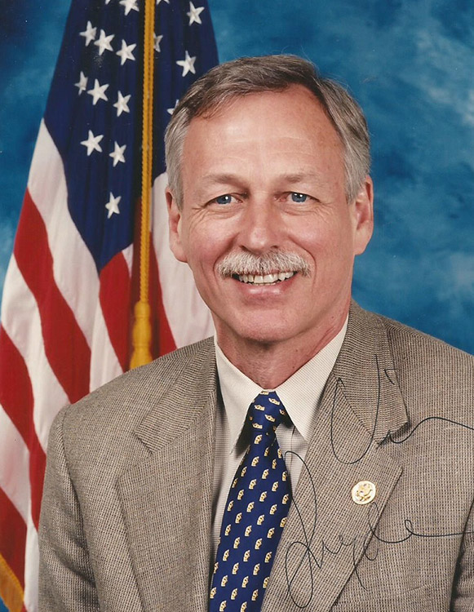
Notes:
Victor F. Snyder (1947–)
Victor Frederick Snyder served seven terms in the U.S. Congress representing Arkansas’s Second Congressional District. Snyder’s experiences in the U.S. Marine Corps, as a family physician, and as a lawyer have helped shape his career in government service.
Vic Snyder was born in 1947 in Oregon. In 1965, Snyder graduated from Medford High School and enrolled in Willamette University. Two years later, he joined the U.S. Marine Corps, serving from 1967 to 1969, including one year in Vietnam. Returning to school, Snyder graduated from Willamette in 1975 with a bachelor’s degree in chemistry and then went on to earn an MD from the University of Oregon Health Sciences Center in 1979.
Following graduation, Snyder became a family practice resident at the University of Arkansas for Medical Sciences (UAMS) in Little Rock (Pulaski County). After completing his residency in '82, Snyder remained in central Arkansas, working as a family practice physician. In 1985, he enrolled in what is now the University of Arkansas at Little Rock William H. Bowen School of Law, receiving a law degree in 1988. He ran for the state Senate as a Democrat in 1990 and won. During his three terms in the state Senate, Snyder was known for his support of conservation issues, his efforts to overturn anti-gay laws in Arkansas, and his challenge to the power of the Arkansas Highway Commission.
Snyder first ran for U.S. Congress in 1996. Defeating Republican Bud Cummins by roughly 10,000 votes (out of nearly 220,000 votes cast in the Second District), he joined Marion Berry and Asa Hutchinson as freshmen in Congress, along with Jay Dickey. Reelected six times, Snyder was in Congress for the second term of President Bill Clinton, both terms of President George W. Bush, and the first half of President Barack Obama’s first term.
In Congress, Snyder has served on the House Committee on Veterans’ Affairs, the House Armed Services Committee, and the Joint Economic Committee. In 2007, he was elected chair of the House Armed Services Subcommittee on Oversight and Investigations. Snyder was the only member of the Arkansas delegation in the House to vote against the 2003 resolution authorizing the use of military force in Iraq. In 2009, he was also the lone Arkansas congressional delegate to vote in support of climate-change legislation.
Snyder married Elizabeth (Betsy) Singleton in July 2003; she was then pastor of the Quapaw Quarter United Methodist Church in Little Rock. They have four sons.

Slide 15


Wright
Arkansas
vs.
Obergefell
Hodges
vs.
Notes:
Wright v. Arkansas
The legal challenge to Arkansas’s gay marriage ban began on July 1, 2013, when a group of gay couples, denied marriage licenses by local Arkansas officials, filed suit. The original plaintiffs were subsequently joined by others so that, by the time the case was heard in court, it included an array of plaintiffs, some of whom had been denied in their efforts to marry, as well as others whose marriages, while legally sanctioned in other jurisdictions, were not recognized by Arkansas law. In bringing their suits, the plaintiffs argued that Sections 9-11-208 and 9-11-107 of the Arkansas Code, as well as Amendment 83 of the state constitution, were denials of their rights under the due process and equal protection clauses of the U.S. Constitution. Given that some of the plaintiffs had marriages that had been fully sanctioned in other states, they also argued that Arkansas’s denial of marriage rights was a violation of the Constitution’s full faith and credit clause.
Circuit Court judge Chris Piazza granted the plaintiffs’ request for summary judgement, declaring that the state’s ban on same-sex marriage was a violation of both the federal and state Constitution.
Judge Piazza’s decision addressed two specific legal provisions. The first, Act 144, enacted in 1997 by the Arkansas General Assembly, declared that “A marriage shall be only between a man and woman,” adding that “A marriage between persons of the same sex is void.” Meanwhile, the second contested provision, Amendment 83 of the Arkansas Constitution, approved in a public referendum on November 2, 2004, said essentially the same thing as Act 144, although it added a crucial provision: even people married in other states remained unmarried as defined by Arkansas law and their professed unions would not be valid or recognized in the state. The laws also noted that the legislature had the authority to determine both who could marry as well as which rights and responsibilities accompanied the marital state. Ultimately, Piazza’s ruling was based in the equal protection and the due process clauses of the Fourteenth Amendment to U.S. Constitution, as well as Article 2, section 2 of the Arkansas Constitution.
Immediately after Judge Piazza’s ruling, more than 500 same-sex marriage licenses were issued across the state. The judge himself became a flashpoint in Arkansas politics, with supporters calling him a hero and opponents demanding his impeachment. Meanwhile, in an emergency filing by Attorney General Dustin McDaniel, a Democrat, the state asked the Arkansas Supreme Court to intervene and stay Piazza’s order so as “to avoid confusion and uncertainty.” The Court complied, issuing a stay pending both further review and an expected decision by the U.S. Supreme Court.
The situation in Arkansas was in many ways reflective of the confusion that existed across the country in regards to the issue of gay marriage. With the issuance of the stay by the Arkansas Supreme Court, the state became the fifth state operating in the legal limbo resulting from the state courts’ desire to give the matter further review while also waiting for more definitive guidance from the U.S. Supreme Court. Meanwhile, the seventeen states (plus the District of Columbia) that had—through legislation, referendum, or court decision—legalized the practice also awaited a high court ruling that would resolve the ongoing inconsistencies.
Reports indicate that the Arkansas Supreme Court, a body that had previously experienced divisive debates over issues related to homosexuality (specifically, the state’s sodomy laws as well as its restrictions on the rights of gay individuals to adopt or serve as foster parents), was engaged in another round of acrimonious and politically charged deliberations. These proceedings were magnified by the partisan change in the state government, with Republicans securing both branches of the legislature and all of the constitutional offices in the 2014 elections. In addition, debates over whether the judges running for reelection in the 2014 contests should recuse themselves also flared. Although preliminary efforts were undertaken to have the case reviewed by a special panel, the new occupants in both the governor’s and attorney general’s offices slowed the process.
Things remained in limbo until the U.S. Supreme Court acted. The resolution finally came at the end of the Court’s 2014–2015 session in Obergefell v. Hodges. In that decision, handed down on June 26, 2015, the Court, by a 5–4 vote in an opinion authored by Justice Anthony Kennedy, upheld the right of same-sex couples to marry anywhere in the United States. While it did not end ongoing debate surrounding the issue of gay marriage and LGBTQ rights in the United States, Obergefell v. Hodges did bring the case of Wright v. Arkansas to a conclusion.

Slide 16
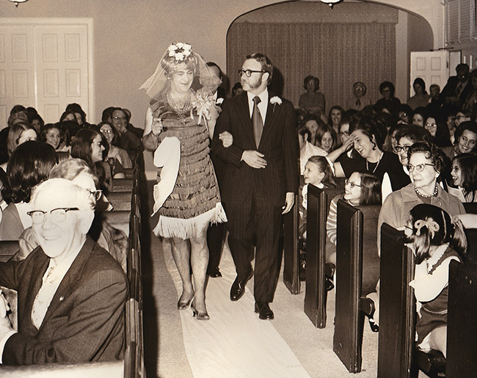
Notes:
Drag Shows
Arkansas has a long history of cross dressing, often called dressing in “drag.” Drag shows in the state have their roots in rural folk dramas often used as fundraisers for community institutions. Starting in the latter half of the twentieth century, drag in Arkansas became more professional in nature and is closely linked with LGBTQ+ communities across the state.
Before World War II, typical drag productions were staged as part of folk plays or farcical beauty contests. These were advertised as “womanless weddings” or “womanless beauty pageants” designed to serve as fundraisers for community institutions such as churches or schools. Of these, the womanless wedding was by far the favorite in many small towns and hamlets across Arkansas. The wedding would include a man—usually a burly, unshaven, large one—dressed as a bride intending to marry another man. In addition to the role of the bride, all traditionally female parts in the production were played by males.
In 1918, the tiny cotton town of Marked Tree (Poinsett County) staged a “womanless wedding” at a local Methodist church. The event was a benefit for the American Red Cross. The advertisement in the Marked Tree Tribune encouraged townspeople to “buy liberally of the tickets” and went on to say that the production would include a local judge, a college professor, and other well-known townsmen—surely to the delight of those in attendance. This aspect, the mocking of prominent locals against a recognizable backdrop, was a key component to rural folk dramas. Essentially, the play takes an everyday and highly familiar occurrence—a wedding—and mixes into it a great deal of cross dressing, resulting in an absurd and easily produced comedy. In August 1944, guards and other camp personnel staged a womanless wedding for the Japanese Americans interned at the Rohwer Relocation Center in southeast Arkansas. Photographs from the night’s show feature a large cast of camp officials staging a production for a packed house of interned Japanese Americans. According to the camp’s newspaper, the Rohwer Outpost, the production left the audience “rolling in the aisles.”
World War II brought drag out of the rural confines and began to display it for a wider audience in the state. Military-sponsored drag shows were popular both on and off base. Arkansas’s military bases of Camp Pike, Camp Joseph T. Robinson, and Camp Chaffee (now Fort Chaffee) all hosted military drag shows during World War II. According to camp newspapers, these shows were quite popular and were performed regularly. Officers and enlisted men at Arkansas encampments enjoyed shows such as “Queens of the Companies” and “The It Girls.” Though these shows were popular on base, they were hardly confined there. One military drag show, “This is the 66th,” headlined three nights at Robinson Center Music Hall in Little Rock (Pulaski County). The shows were intended to boost civilian morale.
After the war’s end, drag fell out of favor as a mainstream form of entertainment. During the decades to follow, drag gradually began to be seen as an expression of queer communities, with gay bars hosting regular drag nights. The most notable of these clubs is the Discovery night club in Little Rock. Nestled in an otherwise abandoned industrial park along the Arkansas River, the Discovery club is owned and operated by Norman Jones. Jones is himself a famous drag queen in Arkansas and throughout the South. Jones won the first Miss Gay American Pageant in 1973. In 1975, Jones bought the rights to the lucrative pageant and brought the production to Little Rock. With this move, drag began to become more professional, more glitzy, and almost entirely divorced from its rural roots. Nevertheless, drag remains popular in gay bars and clubs across Arkansas, such as in Texarkana (Miller County), Fayetteville (Washington County), and Fort Smith (Sebastian County). Drag queens in Arkansas seek to master the craft as a profession and often tour the state with their acts while vying for pageant titles. However, older-style drag performances still occur in the state, as with the “Womanless Beauty Contest” fundraiser for the Franklin County Fair.
In 2021, drag queen Symone (a.k.a. Reggie Gavin) of Conway (Faulkner County), who earlier built a following at Discovery and Club Sway in Little Rock, was the winner of the thirteenth season of RuPaul’s Drag Race, a competition television program. Later that year, the Special Collections division of the University of Arkansas Libraries launched the Arkansas Drag Community Oral History Project to document the experiences of performers and the broader community.

Slide 17
Notes:
On January 9, 2023, in the wake of a moral panic about transgender individuals and drag shows fostered by conservative activists nationwide, Republican state senators Gary Stubblefield of Branch (Franklin County) and Mary Bentley of Perryville (Perry County) filed SB43, a bill “to classify a drag performance as an adult-oriented business” on par with strip clubs or massage parlors, thus limiting places where such performances could occur, in addition to requiring that all audience members be adults. The bill was an example of model legislation (also known as a “cookie-cutter bill”) using language nearly identical to bills Republicans had already introduced in Arizona, Missouri, Texas, and Tennessee (with other states soon following). SB43 defined a drag performance as one in which an individual “exhibits a gender identity that is different from the performer’s gender assigned at birth” and “performs before an audience of at least two (2) persons for entertainment, whether performed for payment or not” in a manner “intended to appeal to the prurient interest.” The bill passed out of committee unanimously on voice vote on January 19, 2023, and passed the whole Senate on January 24, 2023, with Republicans voting unanimously for it and all Democrats voting against. The bill passed out of the House committee on February 1, 2023. However, prior to a full vote in the House, the bill was heavily amended, removing all reference to drag performances and gender identity; the version that passed the House on February 6, 2023, instead made it illegal for minors to attend an “adult-oriented performance,” or one in which breasts or genitalia are exposed or sexual activity is depicted. Governor Sarah Huckabee Sanders signed this bill into law on February 24, 2023.
In May 2023, the nonprofit group Northwest Arkansas (NWA) Equality released a statement that announced that all official Northwest Arkansas (NWA) Pride events would be pulled from the Walton Arts Center (WAC) in Fayetteville because the center had called off what it referred to as “drag performances by adults specifically for minors.” A spokesperson for the center said that the decision had been due to safety concerns and “divisive political rhetoric at this time.” It was reported, however, that the Walton Arts Center’s board had not held a vote to restrict the performances. The director of NWA Pride announced that the Pride celebration would move forward amid overwhelming community support, with programming moving to other locations. Nine members of the WAC board and at least one employee resigned in protest of the center’s decision.

Slide 18
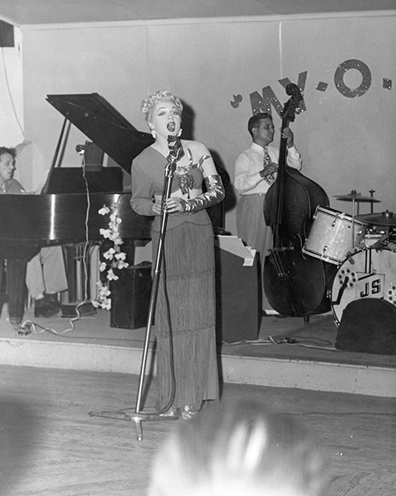
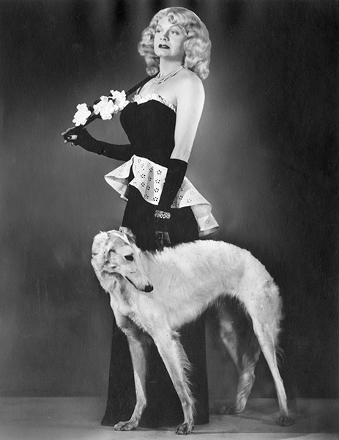
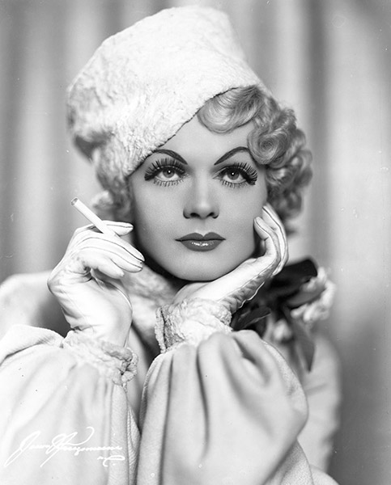
At the My-O-My Club in New Orleans, Harvey Goodwin—as Harvey Lee in a full-length dress—sings in front of a band; circa 1950s.
Harvey Goodwin poses as Harvey Lee in a woman’s formal outfit; 1936.
Harvey Goodwin poses as Harvey Lee with a borzoi; 1945.
Notes:
Harvey Wilson Goodwin (1912–1992) aka Harvey Lee was a gifted stage performer, singer, and internationally recognized female impersonator during the decades of the 1930s, 1940s, and 1950s.
Harvey Wilson Goodwin was born in 1912 in Little Rock (Pulaski County). His family recognized and supported his early interest in the theater: his father arranged makeshift stages out of canvas and drapery material for Goodwin’s neighborhood theatrical performances. Goodwin attended elementary school in Little Rock, graduated from Little Rock High School in 1930, and briefly attended business school before he left for Washington DC, where he found employment as a clerical worker for the U.S. Bureau of Public Health. He also studied dance and music, making his first appearance as a female impersonator in a 1933 dance recital. While retaining his clerical job in Washington DC, Goodwin polished his skills as a female impersonator and performed evenings and weekends around the East Coast. Goodwin subsequently performed as a female impersonator in locations such as Arkansas, California, Texas, Louisiana, Minnesota, Oregon, France, and Germany.
Goodwin began his professional employment as a female impersonator when New York City’s Club Richman hired him in 1934, whereupon he resigned from the U.S. Bureau of Public Health. During his employment with Club Richman, Warner Bros.–Vitaphone Movie Studio offered him a featured role as a femme fatale in the movie The City Slicker. Goodwin was compared to the movie star Jean Harlow, who at the time was at the height of her movie career. Goodwin’s theatrical career flourished until 1936, when he was rushed to a Baltimore, Maryland, hospital with a 104-degree fever. He was diagnosed with pneumonia, but X-rays later revealed that Goodwin had tuberculosis. From 1936 to 1941, Goodwin nursed his health in a sanatorium, and doctors recommended that he leave show business for more sedate employment.
In 1941, Goodwin returned to Arkansas and secured clerical employment at Camp Joseph T. Robinson in North Little Rock (Pulaski County). There, soldiers and civilians learned of the talent they had in their midst and coaxed Goodwin to return to the stage. In 1942, Goodwin appeared on stage as a female impersonator, headlining as “Harvey Lee” at the Arkansas Ordnance Plant in Jacksonville (Pulaski County) to a capacity crowd of 5,000 factory workers. In 1943, Goodwin’s medical condition again deteriorated, and he moved to California to recuperate. In California, he initially worked in the florist business but soon returned to the theater, where he secured a position at Finocchio’s night club in San Francisco.
In 1947, Goodwin, continuing under the name of Harvey Lee, acquired his signature theatrical partner: Nikki, a white male borzoi (or Russian wolfhound). Nikki complemented Goodwin’s act and was featured in fashion shows and on stage during his performances. In 1951, Nikki accompanied Goodwin while he sang on stage at the Moroccan Village in Greenwich Village, New York City, to the great approval of the crowds. In addition, Nikki accompanied Goodwin during the 1952 New Year’s Mummers Parade in Philadelphia, Pennsylvania, where they were featured by television reporters as Goodwin won first prize for best female impersonator in the parade.
In 1952, Goodwin experienced a third bout with tuberculosis and was hospitalized in NY; he was released in October 1953. During the next four years in NYC, Goodwin worked in various clerical positions. In 1957, Goodwin felt sufficiently well to return to show business, performing on stage in France and Germany until 1958. He then returned to New York City to resume office work via temporary agencies. In 1964, Goodwin returned to the West Coast, where he worked in various California theater venues, including Finocchio’s in San Francisco from 1964 to 1966. After 1967, he worked sporadically in show business, staging his San Francisco farewell performance in 1984.
After the 1989 San Francisco earthquake, Goodwin returned to Little Rock, where he died in 1992 from tuberculosis complications. Goodwin is buried in Greers Chapel Cemetery in Magnolia (Columbia County).

Slide 19
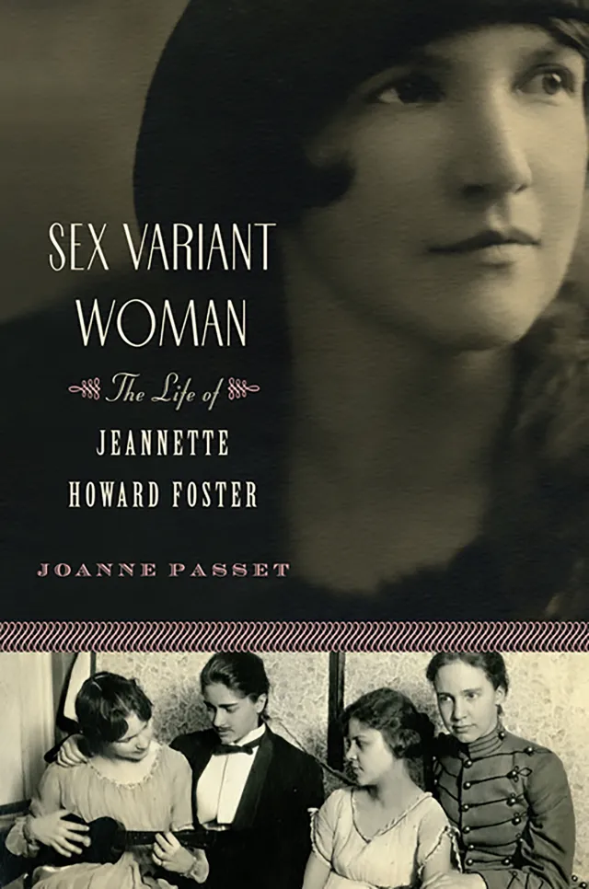
Notes:
Jeannette Howard Foster (1895–1981) was a scholar and librarian who self-published "Sex Variant Women in Literature" in 1956. A study of representations of lesbians and lesbian behavior in Western literature from Sappho and the Bible to the twentieth century, "Sex Variant Women" opened the way for future studies of lesbian history and literature. Foster lived in Pocahontas (Randolph County) from 1974 until her death in 1981.
Foster was born in Illinois in 1895. Foster’s mother, Anna Mabel Burr, had hoped to pursue a career in music and resented her duties as a wife and mother; consequently, she insisted that her daughters concentrate upon education, which would give them the option of self-sufficiency. Foster’s father, Winslow Howard Foster, was extremely driven but suffered from bouts of nervous collapse. As their economic fortunes fluctuated, the family moved around the suburbs of Chicago, and Foster would keep up the habit of moving as an adult; she lived in seventeen states over the course of her life.
Foster entered Calumet High School in 1907 at age eleven. Her intense fondness for a biology and chemistry teacher named Nell Jackson led her to study chemistry first at the University of Chicago, which she entered in 1912, and then at Rockford College, a women’s college where she transferred after a breakdown in 1915. There, she discovered the works of Havelock Ellis and became aware that the phenomenon of “sexual inversion” in women was a subject of formal study in psychology.
After college, Foster taught chemistry before returning to university for graduate work in English, earning an MA in 1922. She taught before entering the Emory University Library School in 1931. She earned a BLS and began work as a science librarian. She entered the Graduate Library School at the University of Chicago in 1933 and received a PhD in '35.
Foster had been collecting literature dealing with lesbian experience since the 1920s, and in 1936, a summer substitute position at the New York Public Library allowed her to begin the research that would culminate in "Sex Variant Women." Foster had to use great care to frame her requests for works with such titles as Female Sex Perversion. A summer position in Washington DC gave Foster the opportunity to pursue her own research at the Library of Congress.
In 1950, Foster became involved with fellow Institute for Sexual Research employee Hazel Toliver, a Greek and Latin translator who was born in Fayetteville (Washington County) in 1909. Toliver was to become Foster’s long-time partner, though their domestic life also involved Toliver’s mother, Myrtle, and later another person who held at least some romantic interest for Toliver. Toliver and Foster grew discontented and left in 1951 for jobs at what is now the University of Missouri–Kansas City.
During her years in Kansas City, Foster finished and published "Sex Variant Women in Literature." As her biographer notes, in the 1950s in America, “homosexuals were condemned by the psychiatric and medical professions as pathological, by religious groups as immoral and sinful, and by the law as criminal.” But Foster was so certain of the value of her work that she did not believe that anyone would condemn it. "Sex Variant Women in Literature" surveys 324 works of literature and history for their treatment of love between women. Foster also consulted some 300 “scientific and psychiatric” works to lend extra respectability to her project.
Foster retired from UMKC in 1960 and joined Hazel Toliver and Toliver’s new companion, Dorothy “Dot” Ross, in St. Charles, Missouri. Foster’s health declined over the next thirteen years, as did that of Toliver’s mother, Myrtle. Because the Tolivers had family in Arkansas near Pocahontas, the women decided to relocate to Randolph County. They bought land on Baltz Lake.
Foster's final years were enlivened somewhat by correspondence with her friends all over the country, and by a renewed interest in her work thanks to the women’s liberation and gay liberation movements of the 1960s and 1970s.
On July 9, 1974, Foster received the third annual Gay Book Award from the Gay and Lesbian Task Force of the American Library Association. Foster died in 1981. She is buried in the Chesser Cemetery in Randolph County.

Slide 20
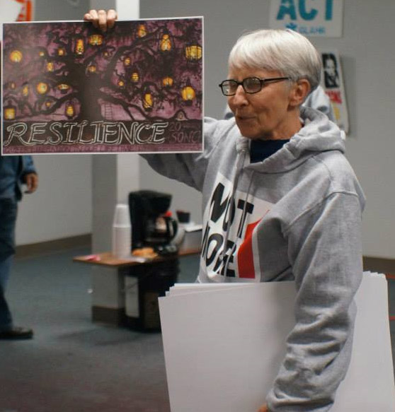
Notes:
Suzanne Pharr (1939–) is a longtime activist for social justice. As an author, organizer, and strategist, she has led numerous campaigns aimed at ensuring equality and justice. In 1981, Pharr founded the Women’s Project, a feminist, anti-racist organization based in Little Rock (Pulaski County), and worked with women in small towns throughout Arkansas.
Suzanne Pharr was born in 1939 in Georgia. She grew up on a farm and played basketball. Pharr attended Women’s College of Georgia where she earned a BA in English. In 1964, she was awarded an MA in English by the State University of New York at Buffalo, and she later completed all the requirements except her dissertation in Tulane University’s doctoral program in American literature.
Pharr spent most of the 1960s teaching before moving into social activism. Beginning in graduate school and continuing until 1972, she taught in numerous settings, including high school, community college, and four-year college; she even spent a year as a lecturer at the University of Canterbury in New Zealand.
In 1973, she left the classroom and moved to a feminist farm in northwestern Arkansas. In 1977, she took a job as the director of Washington County’s Head Start program in Fayetteville (Washington County), a position she held until 1979, when she became a researcher for the Senior Needs Projects of ACTION/VISTA for northwestern Arkansas. She left that job in 1981 to found the Women’s Project in Little Rock, serving as director until 1991 and remaining on the staff until 1999.
After coming out as a lesbian during her time at Tulane, Pharr began focusing much of her activism on gender and sexuality issues, and in particular violence against women. Pharr’s work at the Women’s Project included developing the Women’s Watchcare Network, a group that monitors and documents racist, religious-based, sexist, and anti-gay violence. She also led the work against the political and theocratic rightwing that grew in response to the civil rights movement. She wrote for "Transformation," the organization’s newsletter. She twice served as the coordinator for the national conference for the National Coalition Against Domestic Violence. Throughout her time with the Women’s Project, Pharr led workshops across the country. Averaging about twenty workshops a year for audiences at businesses, schools, civic organizations, churches, and unions, she gave presentations on homophobia, sexism, economic injustice, and other social justice–oriented topics. Pharr was the co-founder of one of the first domestic-violence shelters in Arkansas and a co-founder of the Children’s House in Fayetteville. In 1993 she was one of the co-founders of the group Southerners on New Ground (SONG).
With the Women’s Project as a base, Pharr began serving as a political strategist. She saw electoral politics as an effective vehicle for the change and social justice she sought. She became involved in local and national electoral campaigns, including the presidential campaign of Jesse Jackson in 1988. In 1992, she served as a press officer for the Oregon “No on 9” campaign that successfully defeated an anti-gay ballot initiative; that same year, she was a lead organizer for the National Gay and Lesbian Task Force at the Republican National Convention.
Leaving the Women’s Project in 1999, she moved to the Highlander Research and Education Center, a historic civil rights/popular education organization based in Tennessee, that focuses on social and economic justice. From 1999 to 2004, Pharr served as director—the first woman to hold the position.
Pharr has authored two books, "Homophobia: A Weapon of Sexism," which was originally published in 1988 and was updated in 1997, as well as "In the Time of the Right: Reflections on Liberation," which was published in 1996. Pharr has also published more than fifty essays in a variety of journals and newsletters. Her essays have also been included in textbooks and anthologies.
Working from Knoxville, Tennessee, she became a national political consultant. In that role, Pharr worked on political campaigns and grassroots efforts such as the Rural Organizing Project, an organization aimed at raising consciousness and awareness about the threat from the political right. She organized a similar effort at the Esperanza Peace and Justice Center, in San Antonio, Texas.
Pharr has served on numerous boards and been awarded numerous accolades. After more than a decade living in Knoxville, Pharr returned to Arkansas and settled in Little Rock. She is currently active as a board member of Project South, a member of the Governance Council of the Southern Movement Assembly, and a leader within the National Council of Elders. In 2021, she published a collection of essays and speeches titled "Transformation: Toward a People’s Democracy."

Slide 21

Marisa N. Pavan, et al.
Nathaniel Smith
vs.
Notes:
Marisa N. Pavan, et al. v. Nathaniel Smith aka: Pavan v. Smith
Marisa and Terrah Pavan --legally married in New Hampshire in 2011
Leigh and Jana Jacobs --legally married in Iowa in 2010
In both cases, the couple uses an anonymous sperm donor, one partner carries the child to term, gives birth in 2015. Couples complete the application to receive the birth certificate listing both women as parents. Arkansas Department of Health issues the child’s birth certificate listing only the biological parent.
Under Arkansas law, when a different-sex married couple has a child, the husband of the birth mother is automatically named on the birth certificate as the child’s parent no matter how the couple conceived the child; even if the child was born through donor insemination and therefore is not genetically related to the spouse, state law requires that he be named on the birth certificate as a parent.
The state’s refusal to issue birth certificates naming both parents to the Pavan and Jacobs families violated the clear ruling of the United States Supreme Court in its 2015 marriage equality decision, Obergefell v. Hodges, which requires states to treat the marriages of same-sex couples the same as other couples’ marriages for all purposes under the law.
The Jacobses and Pavans filed a lawsuit in Arkansas state court against the director of the Arkansas Department of Health seeking a declaration that Arkansas’ birth certificate law violated the United States Constitution by treating married same-sex couples differently than other married couples. The state trial court agreed, found the statute unconstitutional, and ruled that the birth certificate law violated Obergefell because it categorically prohibited married same-sex couples from enjoying the same spousal benefits which are available to all other married couples. However, a divided Arkansas Supreme Court reversed that judgment and ruled that the birth certificate statute was constitutional, on the basis that its focus was the biological relationship between a child and each parent, not on the marital relationship between the parents.
The couples petitioned the US Supreme Court to overturn the decision of the Arkansas Supreme Court. On June 26, 2017, the U.S. Supreme Court granted the petition and reversed the decision of the Arkansas Supreme Court. The Court ruled that by treating married same-sex couples differently than other married couples, the Arkansas birth certificate law “denied married same-sex couples access to the ‘constellation of benefits that the Stat[e] ha[s] linked to marriage'” and therefore violated the Court’s decision in Obergefell.
Essentially, a state rule that requires a child’s birth certificate to list the non-biological father if he is married to the biological mother but that does not allow both same-sex spouses to be listed as parents is unconstitutional discrimination that violates Obergefell v. Hodges. In a per curiam opinion, the Court held that the rule functionally deprives married same-sex couples the same rights to be listed on their children’s birth certificates as married opposite-sex couples have. Not being listed on a child’s birth certificate can significantly affect a parent’s ability to participate in transactions that require showing proof of parentage. Therefore, this rule unconstitutionally discriminates against married same-sex couples by denying them access to the same rights, responsibilities, and benefits that married opposite-sex couples have.

Slide 22

QUESTIONS
Notes:
This is just the tip of the iceberg. The Encyclopedia of Arkansas is a rabbit hole I encourage you to jump down. No matter what you are interested in, Arkansas has it--and the EOA is where you can start looking.

