Slide 1


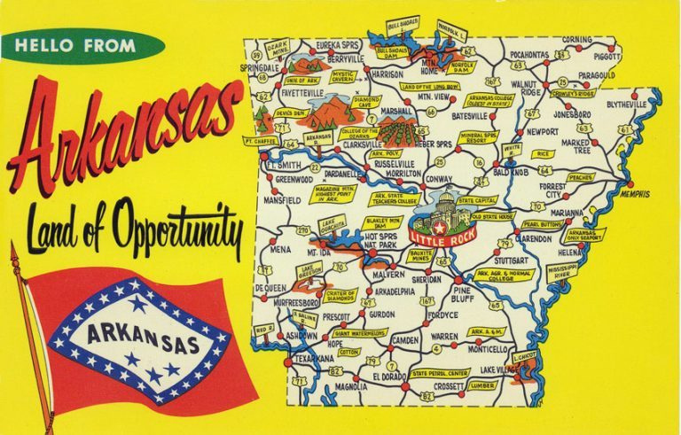
10 BLACK
ARKANSANS
IN BUSINESS
Notes:
Whether you're a born and raised Arkansan, lived here for 30 plus years, or recently arrived to the Natural State, this place we call home has a rich, diverse, and unique history.
Since the website was launched in the mid-2000s, the staff of the Encyclopedia of Arkansas has tried to make sure that the story of this place is documented in an accessible digital format.
This free resource has almost everything you might want to know about the 25th state. And the EOA staff are in the habit of finding the most fascinating of those stories to tell.

Slide 2

Notes:
The CALS Encyclopedia of Arkansas launched in 2006 with 700 entries and 900 pieces of media.
In 2019 we switched platforms from the original proprietary website to a newly designed WordPress site.
In August 2022 we undertook a further redesign of the home page, search function, and user experience features.
You can stop by the EOA for tidbits like THIS DAY IN ARKANSAS HISTORY and PHOTO OF THE DAY...
As well as trending entries and what's been newly updated. (And here's a hint, we are updating all the time!)

Slide 3

7,000+
entries
Notes:
We have over 7,000 entries.
We are often compared to Wikipedia but the difference is that our entries are peer reviewed and professionally edited.
Anyone can write for the EOA but all entries are reviewed by other scholars, fact checked, and edited for grammar and spelling.

Slide 4
  EVERY incorporated community
  Government officials
  Civil rights organizations from NAACP to CLOB
  EVERY military action including the smallest skirmishes
  Wildlife, flowers, plants
Notes:
WE HAVE ENTRIES ON ...
Every incorporated community, hundreds of unincorporated ones, and we're always seeking more.
ENTRIES ON
Government officials from those who served in Congress, to Arkansas constitutional officers, to individual state legislators, even significant sheriffs, mayors, and county judges
Civil rights organizations from the national level, such as the NAACP, to the local level, such as CLOB (Council for Liberation of Blacks)
Military events from the Civil War, ranging from major battles (Pea Ridge) down to small local skirmishes; if someone in blue and someone in gray met in the woods between 1861 and 1865 we probably have an entry documenting it.
AND THE NATURAL ENVIRONMENT - birds, fish, mammals but also fungi, lichens, ferns, jellyfishes
AND WE ARE ALWAYS DEVELOPING MORE...
Developing entries on every film set or filmed in Arkansas, as well as every book, television show, and even individual episodes set in the state (Search: X-Files)

Slide 5
Produced by a public library
230 countries
EVERY continent
Notes:
Used by government agencies and officials, students, media, genealogists, historians (local and national)
Users have come from every continent (including Antarctica) and more than 230 countries.
Over 175,000 users per month

Slide 6
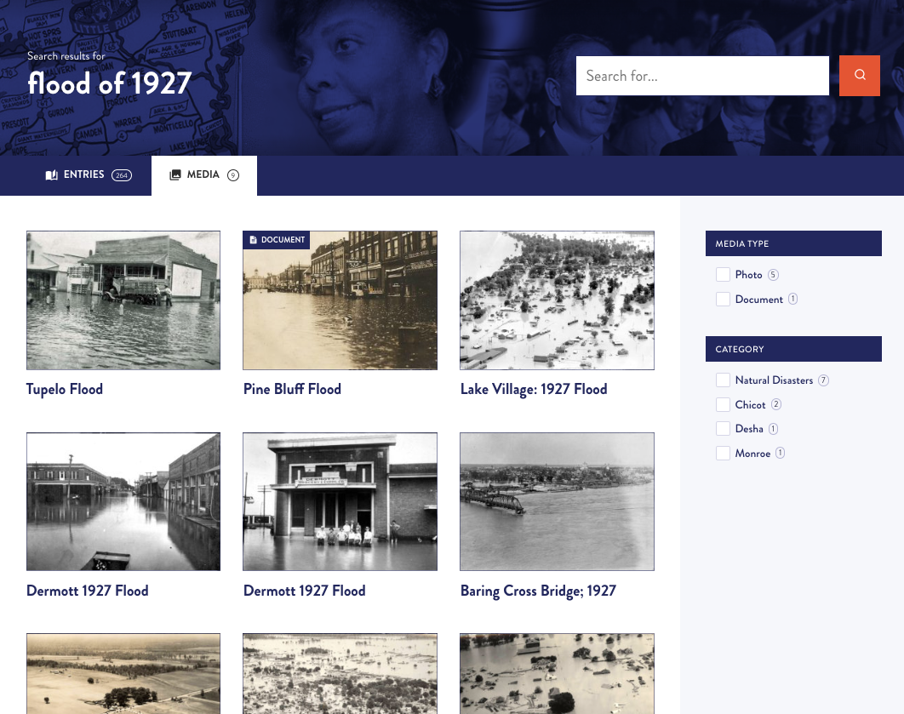
17,000+
media
Notes:
AND BOY DO WE HAVE MEDIA...
We have over 17,000 pieces of media!
We have worked with archives, libraries, museums, and universities around the state and the country to make sure that the EOA has visual images to illustrate our entries.
BUT THERE IS ALWAYS MORE TO FIND...
We rely on everyday citizens to help us locate photos.

Slide 7
10 BLACK
ARKANSANS
IN BUSINESS

Slide 8
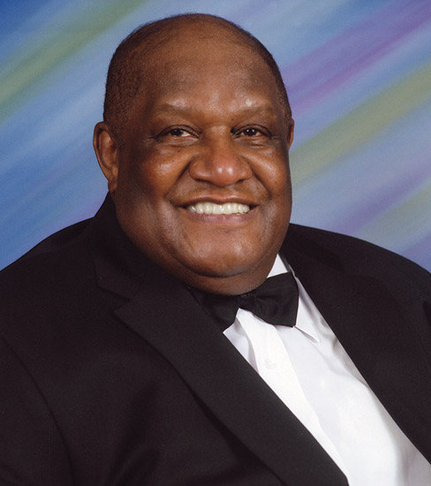

Notes:
William Delford Willie Davis (1934–2020) was a millionaire business executive, civic leader, and former football standout who grew up in Miller County. Davis achieved athletic success in football at the high school, college, and professional levels. After retiring from a National Football League (NFL) career of twelve seasons (1958–1969), he moved into the business world, where he attained equal success.
Davis was born in 1934 in Louisiana and grew up in Texarkana (Miller County). He worked two jobs while attending high school.
After high school, Davis was recruited by the legendary college coach Eddie Robinson at Louisiana’s Grambling State University. Davis served as defensive team captain for two years and was twice named to the All America team for Black colleges.
Davis was drafted in the fifteenth round by the NFL’s Cleveland Browns. Just two weeks into his NFL career in 1956, he was drafted into the US Army. In 1958 after two years in the military he began his professional football career.
Davis played two seasons for the Browns before being traded to the Green Bay Packers. In his pro career, he played in 162 consecutive games, 138 of which were during his ten years with the Packers. As a Packer, the 6’3″, 245-pound defensive lineman played on six championship teams including Super Bowl I in 1967 and Super Bowl II in 1968.
Davis retired from football in 1969. In 1975 he was inducted into the Packers Hall of Fame and in 1981 he was inducted into the National Football Hall of Fame.
During his last years as a player, Davis attended the University of Chicago, earning a master’s in business administration. He purchased the West Coast Beverage Company and served as its president for the next eighteen years. He also served as a color commentator for NFL broadcasts for the National Broadcasting Company (NBC). In 1976, he became president and CEO of All Pro Broadcasting, Inc. Davis was inducted into the Arkansas Black Hall of Fame in 2007.

Slide 9
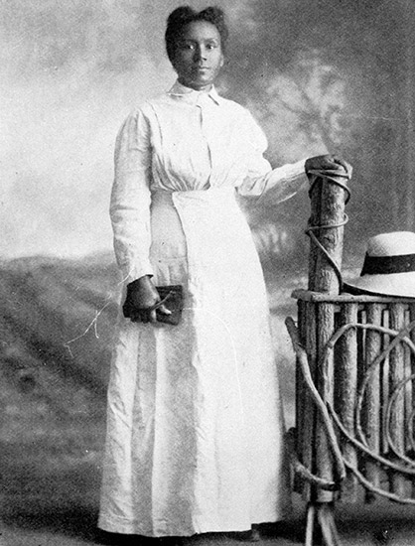

Notes:
Eliza Ann Ross Miller (1869–1938) was an African-American businesswoman and educator, as well as the first woman to build and operate a movie theater in Arkansas. She was the wife of prosperous Helena (Phillips County) businessman Abraham Hugo Miller. After her husband’s death, she continued his business operations while also providing leadership in the Helena school system. She was inducted into the Arkansas Black Hall of Fame in 1999.
Eliza Ann Ross was born in Arkadelphia (Clark County) in 1869. In 1887, she married Abraham H. Miller. They had eight children. Abraham Miller praised his wife's abilities as a “collector, supervisor secretary, bookkeeper and general manager.”
After Abraham’s death in 1913, Eliza Miller built the Plaza Theatre in downtown Helena. In 1921, the Plaza showed a film starring Black actor Sidney P. Dones with an “all Colored Star cast.” By the 1920s, Miller’s son Lucian was living with her and running the Plaza but by the 1930s, Eliza Miller was again in charge and operated the theater until she died.
She served on the board of trustees at Arkansas Baptist College in Little Rock (Pulaski County). In the mid-1920s, she bought land; in 1926, Eliza Miller High School, the first African-American high school in the area, was established on site. In later years, the Eliza Miller Award was given to the best teachers at the school. Miller died in 1938.
In 1970, Eliza Miller High School was desegregated and repurposed as a junior high school. In 1978, Eliza Miller Park was established in Helena. Three schools in the area now bear her name: Eliza Miller Junior High School, Eliza Miller Elementary School, and Eliza Miller Primary School. In 2003, the Arkansas General Assembly recognized Miller: “Eliza Miller’s legacy to her family and today’s Black youth is the value of an education, determination, and respect.” That same year student and filmmaker Dana Bingham completed a short film about Miller funded by the Arkansas Humanities Council.

Slide 10
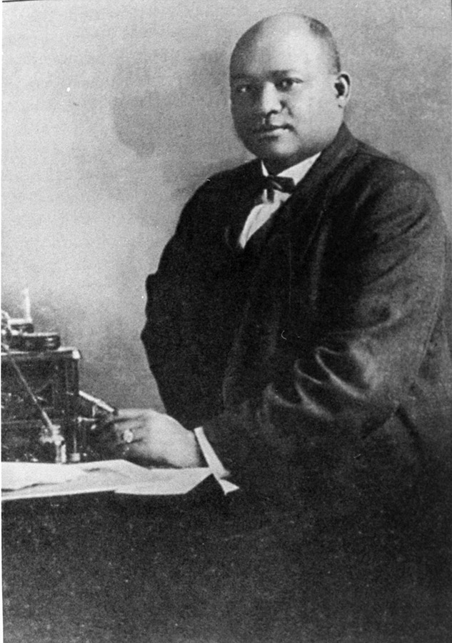
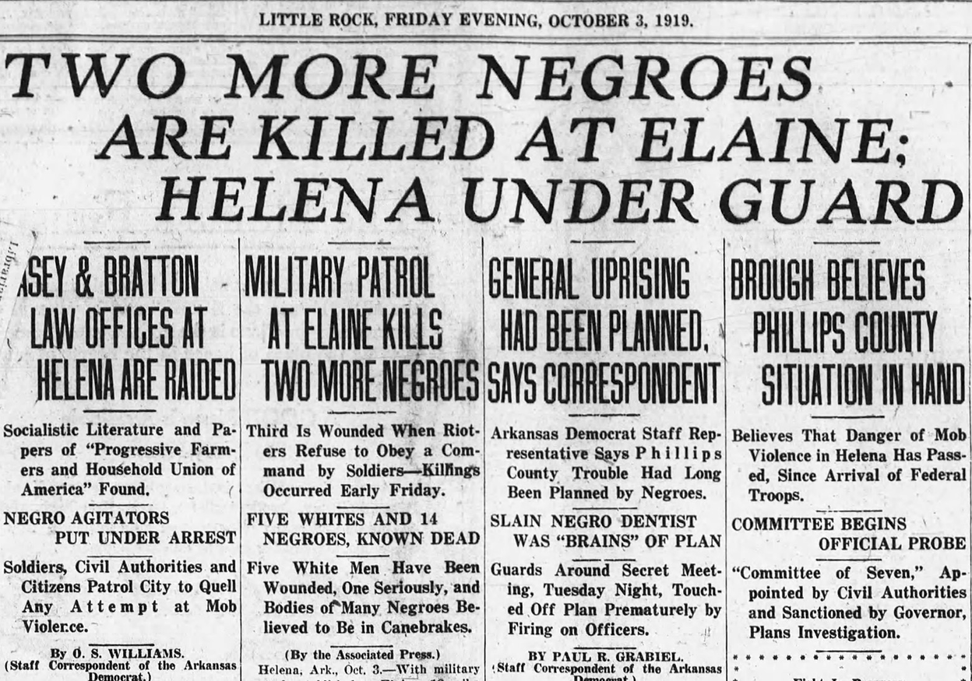

Notes:
David Augustine Elihue Johnston (1878?–1919)
was an inventor and a successful dentist and businessman. He and his brothers were killed during the Elaine Massacre of 1919.
D. A. E. Johnston was born in Pine Bluff (Jefferson County).
Johnston received his dental training at the Chicago School of Dentistry. He practiced there before moving back to practice in Pine Bluff. He then moved to Helena (Phillips County) to set up a practice and established a branch office in Holly Grove (Monroe County).
He married Mariah (or Maria) Estelle Miller, daughter of the Reverend Abraham Hugo Miller and Eliza Ann Ross Miller. Johnston and attorney Scipio A. Jones were among the Arkansas delegates attending the National Negro Business Men’s League convention in New York. They made a plea for the 1911 convention to be held in Little Rock and were successful.
In 1913, Johnston began work on an invention that would improve the typing experience. He applied for a patent and received it in 1917. He was offered $25,000 for the right to manufacture and $50,000 for the ownership of the typewriter attachment. It is unknown if Johnston agreed.
In 1918, Johnston applied for and was granted an exemption from serving in the military during World War I.
In 1919, returning home with his three brothers, Johnston was allegedly approached and warned not to drive to Helena; he was urged to catch the train instead. But Johnston and his three brothers were arrested when they reached Elaine on charges of “distributing ammunition to the insurrectionists.” They were chained together by a white man named Lilly and other members of his posse.
White journalists stated only that Johnston grabbed Lilly’s gun and shot Lilly three to four times, after which the other posse members fired, killing Johnston and his three brothers. By contrast, Black journalists reported that Lilly and Johnston had argued the week before and that Lilly or a friend had tried to whip Johnston but was instead beaten in the fight.

Slide 11
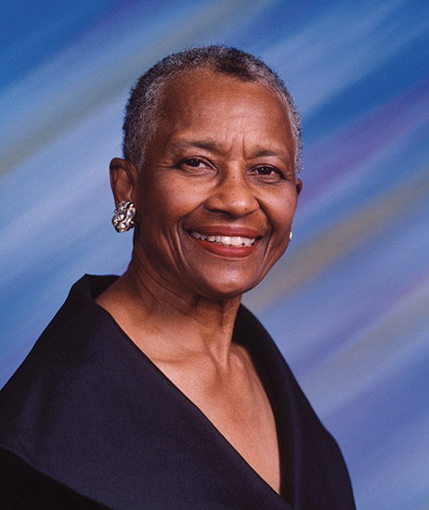

Notes:
Faye Clarke (1931–) co-founded the Educate the Children Foundation, which was created to support rural and impoverished school districts with donations of books and other educational materials. She was inducted into the Arkansas Black Hall of Fame in 2002.
Faye Wilma Robinson was born in 1931 in Pine Bluff (Jefferson County). She was an Arkansas National Merit Scholar and studied at Hampton Institute, then attended a one-year business program at Radcliffe College taught by professors from the Harvard Business School, where women were not yet allowed. she was the first African-American woman in this program. She began working at Aramark, a company that provides food, facility, and uniform services, eventually becoming a regional vice president.
She married Frank Clarke 1982. In her work for Aramark Clarke and her husband frequently traveled and they became aware of the many structural inequalities facing children in lower-income school districts. In particular, the schools of the Mississippi Delta region, where poverty is endemic.
Shocked at the conditions they witnessed, the Clarkes began donating books and calculators to needy school districts in the South. After Faye Clarke retired, the couple used most of her $300,000 retirement fund to establish what became the Educate the Children Foundation, with Clarke as executive director. The foundation worked to obtain surplus materials from educational publishers and discarded furniture from wealthier school districts, opening warehouses in four states.
By 1999, more than $20 million worth of books and other equipment had been distributed to schools in nine states and Washington DC, as well as the U.S. Virgin Islands, Haiti, and Ghana. The Clarkes also established computer labs in various schools, including on Native American reservations, and opened a computer-oriented summer camp for children.
Faye and Frank Clarke received the President’s Service Award from President Bill Clinton and the National Caring Award.

Slide 12
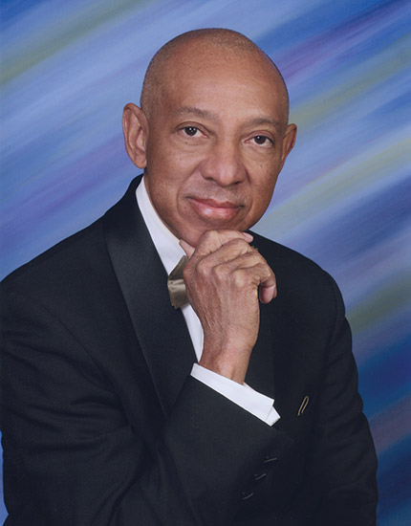

Notes:
Gerald Byron Alley (1952–) is the founder of Con-Real, LP, which is the leading Black-owned construction and real estate firm in Texas, with offices in Arkansas and California. He was inducted into the Arkansas Black Hall of Fame in 2013 and the Arkansas Business Hall of Fame in 2020.
Gerald Alley was born in Pine Bluff (Jefferson County) in 1952. His father was a local businessman who started the Alley ESSO Service Station. After attending local public and private schools and working at his father’s station, Alley enrolled in the University of Arkansas (UA) in Fayetteville (Washington County) at the age of sixteen, majoring in finance. He graduated in 1973. He entered graduate school at Southern Methodist University (SMU) in Dallas, Texas and graduated the following year with an MBA. He carried out additional study at the Kellogg School of Management at Northwestern University in Chicago, Illinois, and was recruited by Sanger-Harris, a retail corporation based in Dallas.
In 1979, Alley founded Con-Real. In the beginning, he and an assistant, who shared a desk, made up the entire staff. His brother Troy joined him as a partner soon after the founding, and Con-Real soon grew into a major force in construction and real estate. Headquartered in Arlington, Texas, it opened offices in Dallas and Houston, as well as Little Rock (Pulaski County) and San Francisco, California. Con-Real regularly provides services to Fortune 500 companies.
Alley also founded The Alley Group (TAG), a project management services company, and Bravado LP, a real estate and hospitality firm. In addition, he co-founded the Candace Alley Family Foundation, which supports organizations providing for the needs of underprivileged students. He has served on numerous boards, including at SMU and UA.
Alley and his wife, Dr. Candace P. Alley, have three children. The government leaders of Tarrant County, Texas, declared October 19, 2013, to be Gerald Byron Alley Day.

Slide 13
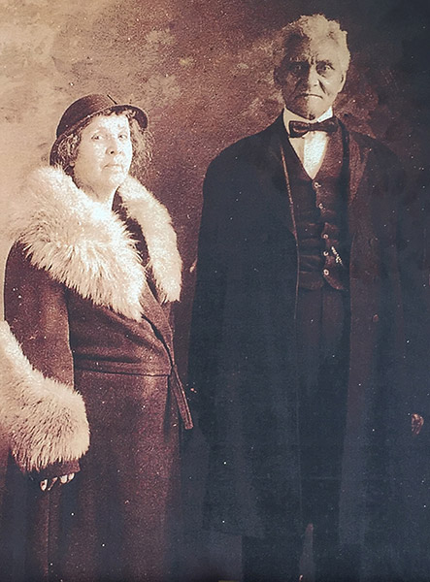

Notes:
Josephine Irvin Harris Pankey (1869–1954) was a real estate developer, educator, philanthropist, and leader in the African-American community of Little Rock (Pulaski County).
Josephine Irvin was born in 1869 in Ohio. She studied music at the Oberlin College conservatory but withdrew because of illness.
She moved to Arkansas to teach and began in DeValls Bluff (Prairie County); she soon became the principal of a group of schools. She traveled via horse and wagon to oversee them.
She married Eugine Harris and they moved to Pine Bluff (Jefferson County). There, she taught and gave music lessons. After three years of marriage, they divorced, and she moved to Little Rock. She continued teaching and joined Bethel African Methodist Episcopal Church. There, she met Samuel Pankey and they married.
The couple became interested in real estate development. In the early 1900s in Little Rock, restrictive covenants limited where Black families could buy land and live, and financing was not generally available from banks. Pankey bought eighty acres along what is now Cantrell Road; it is still known as the Pankey community. She bought two and a half acres off what is now North Cleveland Street. She and her husband lived there. Pankey bought another fifteen acres near what today is Kanis Road. She bought eighty acres adjacent to her first purchase and platted additional lots.
She began working with Worthen Bank. One employee recalled: “On the strength of Mrs. Pankey’s endorsement, [we] made a number of loans to young men who otherwise would not have qualified... If the borrower didn’t pay... I would call Mrs. Pankey.”
Pankey wanted a better life for her community. She organized the first school in the Riverside community, today the Riverdale area of Little Rock. Seeing that African Americans lacked access to books due to segregation laws, Pankey started her own lending library; eventually, she established the first permanent lending library for African Americans in town.

Slide 14
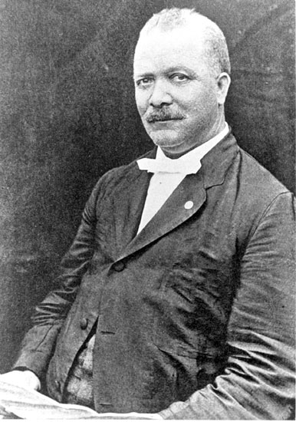

Notes:
John Edward Bush (1856–1916), a chairman of the Republican Party in Arkansas, rose from poverty to national prominence when he co-founded the Mosaic Templars of America (MTA), an African-American fraternal organization of international scope, spanning twenty-six states and six foreign countries from the 1880s until the 1930s. Headquartered in Little Rock (Pulaski County), MTA became one of the largest and most successful Black-owned business enterprises in the nation and the world. Living most of his early life in the downtown 9th Street district of Little Rock, Bush was widely acknowledged as one of the wealthiest Black men in Arkansas and a progenitor of the economic development and progress of Black American entrepreneurs.
John Bush was born a slave in 1856 in Tennessee. His family was brought to Arkansas by their owner and freed after the Civil War, but his mother soon died. He wandered and performed odd jobs to survive. A man saw him and carried him by force to school. Bush liked school so much he studied late at night, often unable to attend during the day.
In order to finance his education, Bush worked as a brick molder. In 1875, a postal clerk for the Railway Mail Service, he became the first Black person to be recommended for chief clerkship. Bush graduated with honors from school and served as principal.
In 1879, Bush married Cora Winfrey, daughter of a prominent Black businessman.
The founding of the Mosaic Templars in 1883 launched Bush’s business career; he and Booker T. Washington became fast friends and supported each other’s endeavors. Washington dedicated the MTA headquarters building. Talented people served as officers, such as his sons Chester and Aldridge, and lawyer Scipio Jones, among others.
President McKinley appointed Bush receiver of the U.S. Land Office at Little Rock. He was subsequently reappointed four additional terms by Presidents Roosevelt and Taft.
Bush died in 1916. His sons Chester and Aldridge continued his legacy.

Slide 15
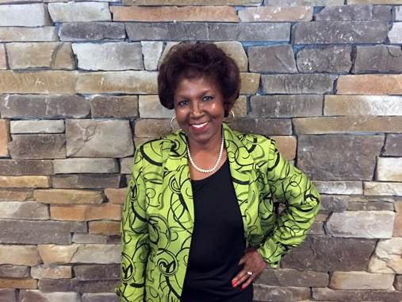

Notes:
Martha Smith Dixon (1946–) is an internationally recognized clothing designer and entrepreneur. Her designs of couture gowns worn by Hillary Clinton during Bill Clinton’s gubernatorial and presidential inaugurations helped launch her career in fashion.
Martha Smith was born in Clark County in 1946. She attended schools in Gurdon and Arkadelphia. She spent two years at Henderson State University before dropping out to work at Levi Strauss. She married Huie Dixon.
Dixon started her first business, Martha’s Designs, walking door-to-door. One boutique placed an order for twelve dresses and within two weeks one of Dixon’s dresses had been selected for Hillary Rodham Clinton. Then Arkansas’s first lady, she wore the dress for the Governor’s Inaugural Ball in 1987 following the reelection of Bill Clinton as governor of Arkansas. The gown was later displayed at the Old State House Museum.
Business picked up after the high-profile order, allowing Dixon to place designs in boutiques in surrounding states. Arkadelphia business leaders helped pay material costs for a second gown for Hillary Clinton, this time at Bill Clinton’s 1993 Presidential Gala Inaugural Ball.
With a $50k loan from the Arkansas Industry Development Council, Dixon created her second business, Dixon Manufacturing. Commercial clients have included Tyson Foods, CARTI, and Walmart. After a devastating fire, Dixon sold Dixon Kids, a children’s clothing line that supplied school uniforms. She gave the hospital uniform portion to an employee and retained the food-services uniform portion.
Dixon served in leadership roles for the Democratic Party, including as Arkansas Democratic National Committeewoman in 2000 and co-chair of the 2008 presidential campaign for Hillary Clinton.
Dixon was recognized as one of the “Top 100 Women of Arkansas” by Arkansas Business magazine and was inducted into the Arkansas Black Hall of Fame in 2005. In 2011, Dixon published her autobiography.

Slide 16
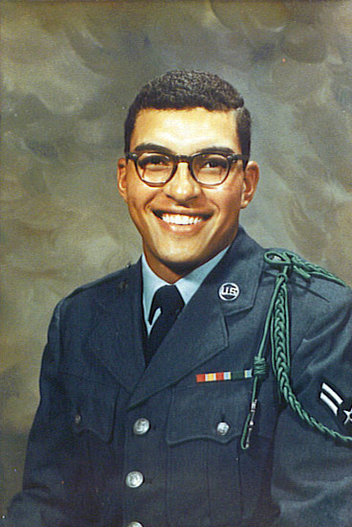

Notes:
James Ronald Rodgers Sr. (1947–1993) was the nation’s first African American to be appointed manager of a major commercial airport, the first Black head of a major independent city agency in Little Rock (Pulaski County), and the state’s first Black commercial loan officer.
James Rodgers was born in 1947 in Little Rock. Rodgers grew up working with his family for his father’s janitorial service.
After graduating from Horace Mann High School Rodgers attended the University of Arkansas at Little Rock for a year and a half before joining the U.S. Air Force. After a four-year stint as a radar technician, he returned to civilian life and resumed his studies at UA Little Rock, graduating with a BS in accounting.
He married Claudia Dennis of North Little Rock.
Rodgers joined First Commercial Bank as a management trainee. He attended the Southwest Graduate School of Banking at Southern Methodist University in Texas. He was promoted to branch manager, followed by a promotion to assistant credit department manager and later to the position of commercial loan officer.
Rodgers joined Bill and Hillary Clinton National Airport as administrative assistant to manager Robert Crisp. In less than three years he was named general assistant manager just before Crisp retired. In 1980, Rodgers was named airport manager at age thirty-three. During his tenure from 1980 to 1993, boardings went from 494,000 to more than one million; a 200,000-square-foot expansion of the terminal was completed; a runway was renovated and extended; and a parallel runway was built. The expansion projects Rodgers coordinated totaled more than $70 million.
Rodgers died in 1993. He is buried at Little Rock National Cemetery. In 1994, Southwest Hospital dedicated its magnetic resonance imaging (MRI) unit to the memory of Rodgers, its former vice chairman of the board. Rodgers was posthumously inducted into the Arkansas Aviation Hall of Fame.

Slide 17
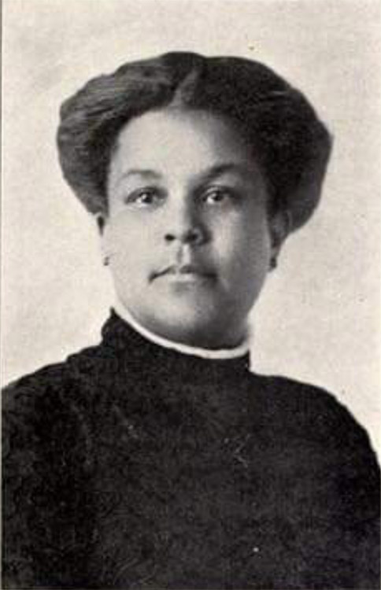

Notes:
Businesswoman and activist Mame Stewart Josenberger (1872–1964) started her career as an educator but assumed control of a variety of businesses. She served as president of the Arkansas Association of Colored Women (AACW) and on the advisory board of The Crisis, the renowned publication of the National Association for the Advancement of Colored People (NAACP).
Mame Stewart was born in 1872. She earned a BA in education at Fisk University and graduated in 1888 alongside scholar and political activist W. E. B. DuBois. Stewart taught in AL and MS before relocating to AR and continuing to teach in Fort Smith (Sebastian County).
Stewart married businessman William Ernest Josenberger. After his death she took over the family business, which included: a funeral home; Josenberger Hall, an entertainment venue; a burial insurance company; and property in the Taborian Heights area of Little Rock. In 1920, Josenberger’s estimated worth was $30k (approximately $400k today).
Josenberger’s community and organizational affiliations were considerable. She was a member of the National Association of Colored Women (NACW) and the Arkansas Association of Colored Women (AACW). She also cofounded Fort Smith’s Phillis Wheatley Federated Club in 1898 and was its president for fifty-six years.
Josenberger was a lifetime member of the NAACP. She grew increasingly involved in anti-lynching, social reform, and global peace activism through the International Council of Women of the Darker Races (ICWDR). Josenberger was an ICWDR executive committee member, finance committee chair, and treasurer.
Her involvement in so many organizations remained consistent over the years even while she managed her businesses. Josenberger died in 1964 and is buried in Fort Smith’s Oak Cemetery.
Josenberger’s organizational affiliations and connections to local, national, and international Black women leaders helped improve African American access to economic, social, and political opportunities.

Slide 18

QUESTIONS
Notes:
This is just the tip of the iceberg. The CALS Encyclopedia of Arkansas is a rabbit hole I encourage you to jump down. No matter what you are interested in, Arkansas has it—and the EOA is where you can start looking.

