Slide 1
FUN FACTS FOR MAY: ASIAN AMERICAN & PACIFIC ISLANDER (AAPI) MONTH
Notes:
Did you know Arkansas is home to many Asian Americans?
The CALS EOA has entries on the Chinese, the Hmong, the Marshallese, and more.

Slide 2
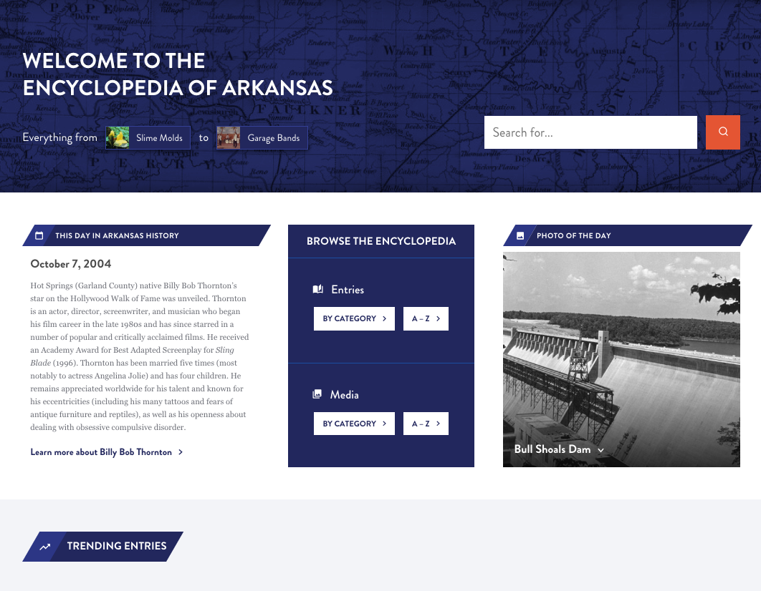
Notes:
The Encyclopedia of Arkansas launched in 2006 with 700 entries and 900 pieces of media.
In 2019 we switched platforms from the original proprietary site to a newly designed WordPress site.
In August 2022 we undertook a further redesign of the home page, search function, and user experience features.
You can stop by the EOA for tidbits like THIS DAY IN ARKANSAS HISTORY and PHOTO OF THE DAY.
You can also see what's trending and what's been newly updated. (Hint, we are updating all the time.)

Slide 3
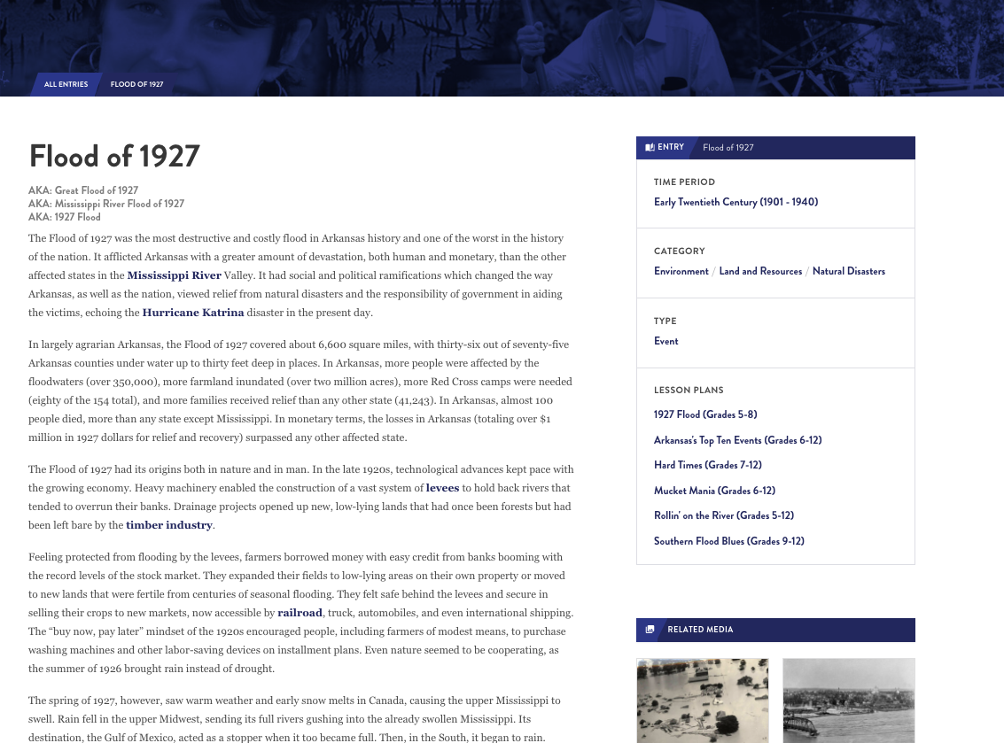
7,000+
entries
Notes:
Over 7000 entries
Often compared to Wikipedia
Peer reviewed and edit entries
Anyone can write for the EOA but all entries are reviewed by other scholars, fact checked and edited for grammar and spelling.

Slide 4
EVERY incorporated community
Government officials
Civil rights organizations from NAACP to CLOB
EVERY military action including the smallest skirmishes
Wildlife, flowers, plants
Notes:
WE HAVE ENTRIES ON ...
Every incorporated community and hundreds of unincorporated ones. If you don't see your town represented, let us know if you want to write the entry on it! Or we may already have someone working on it.
ENTRIES ON
Government officials from those who served in Congress, to Arkansas constitutional officers, to individual state legislators, even significant sheriffs, mayors, and county judges.
Civil rights organizations from the national level, such as the NAACP, to the local level, such as CLOB (Council for Liberation of Blacks)
Military events from the Civil War, ranging from major battles (Pea Ridge) down to small local skirmishes; if someone in blue and someone in grey met in the woods between 1861 and 1865 we probably have an entry documenting it.
AND THE NATURAL ENVIRONMENT - birds, fish, mammals but also fungi, lichens, ferns, jellyfishes
AND WE ARE ALWAYS DEVELOPING MORE...
Developing entries on every film set or filmed in Arkansas, as well as every book, television show, and even individual episodes set in the state (Search: X-Files)

Slide 5
Produced by a public library
Users in 230 countries
EVERY continent
Notes:
Used by government agencies and officials, teachers, students, genealogists, historians (local and national), researchers of all stripes.
Users have come from every continent (including Antarctica) and more than 230 countries.
Over 175,000 users per month.

Slide 6
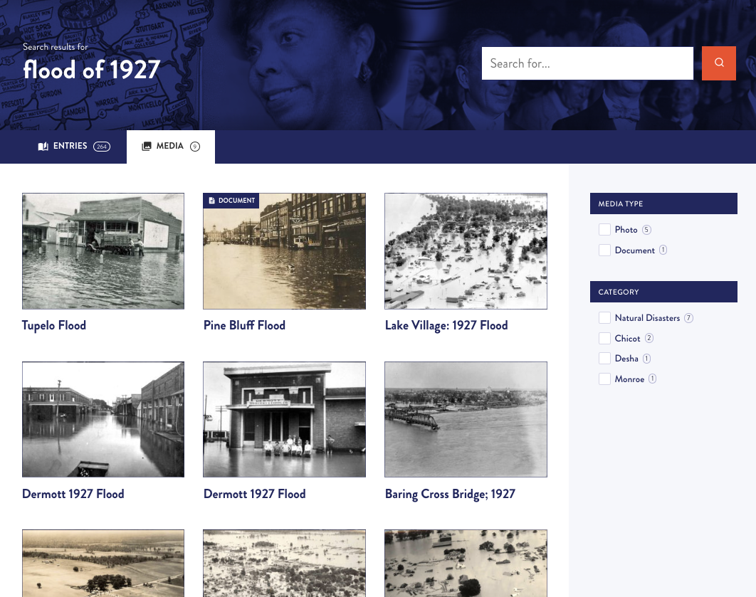
13,000+
media
Notes:
AND DO WE HAVE MEDIA...
Over 13,000 pieces of media
We have worked with archives, libraries, museums, and universities around the state and the country to make sure that the EOA has visual images to illustrate our entries.
BUT THERE IS ALWAYS MORE TO FIND...
We rely on everyday citizens to help us locate photos. If you have a great photo to add to an entry, let us know!
email: info@cals.org

Slide 7
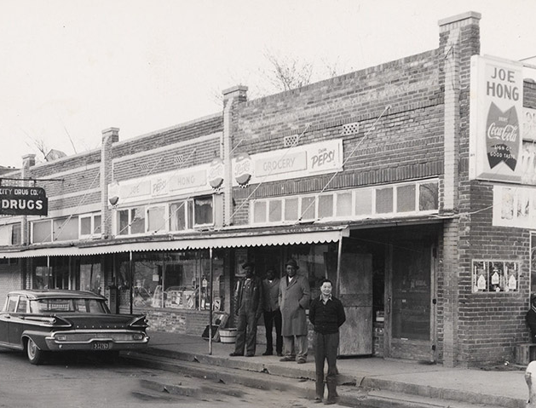
Notes:
Now let's dig into the month of May, during which we celebrate Asian Americans and Pacific Islanders.
Fact 1
(FROM THE CHINESE ENTRY)
Chinese folks have been immigrating to American since at least the 1870s. At first they were employed as cotton field workers; in the 1910s many Chinese people in Arkansas ran laundries; in the 1920s many Chinese people in Arkansas were working in the grocery store business.
This is a picture of Joe Hong Grocery in Tyronza (Poinsett County) from the 1950s.
Chinese Americans today live all over the state, from the Delta to the Ozarks.

Slide 8
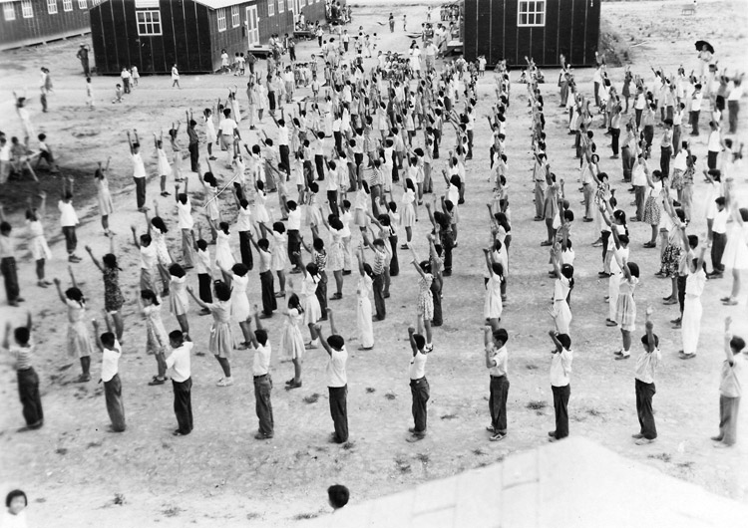
Notes:
Fact 2
Did you know Arkansas had two internment camps during WWII where Japanese families were forced to live?
Japanese Americans were forcibly removed from their homes on the west coast in 1942 and imprisoned in ten incarceration camps including two in Arkansas -- at Jerome and Rohwer.
Understandably, not many Japanese families wanted to stay in Arkansas after WWII. Although Arkansas's Japanese American population today is small, there are several famous folks with Arkansas connections...

Slide 9
Notes:
Fact 3
Yuri Kochiyama was a human rights activist and Nobel Peace Prize Nominee.

Slide 10
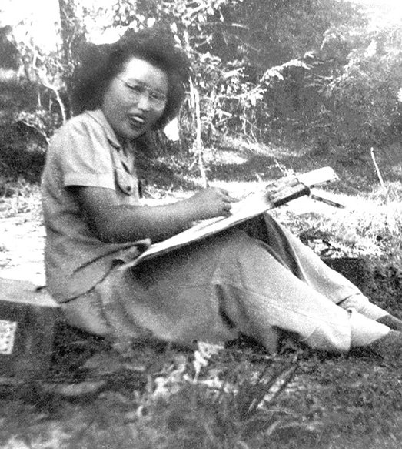
Notes:
Fact 4
Ruth Asawa
was an internationally
acclaimed artist and advocate for arts education.

Slide 11
Notes:
Fact 5
Paul Kazuo Kuroda, professor of chemistry, brought international attention to scientific research in Arkansas.

Slide 12
Notes:
Fact 6
Henry Yuzuru Sugimoto was a noted artist whose paintings chronicled the immigrant experience.

Slide 13
Notes:
Fact 7
Ryan Yoshimoto Kurosaki, the first American of Japanese descent to play in the major leagues, is a former professional baseball player.

Slide 14
Notes:
Fact 8
Nami Shingu was an American citizen born of Japanese parents. She arrived in Arkansas as an internee and left a decade later after her family’s successful farming endeavors allowed them to return to California.

Slide 15
Notes:
Fact 9
And one you may recognize...
George Hosato Takei, who stayed in the camp at Rohwer as a boy, gained international fame as Lieutenant Sulu in the original Star Trek television series and movies.
In 2003, Takei returned to the Rohwer site to assist in preserving the history of the state’s relocation camps. He returned to the state in 2004 to participate in the symposium on Japanese American experiences in Arkansas that was part of the four-day event, “Life Interrupted: The Japanese American Experience in World War II Arkansas.”
In 2005, Takei announced that he is gay and had been with his partner, Brad Altman, for eighteen years. In 2008, he and Altman were married in the wake of the California Supreme Court’s ruling legalizing same-sex marriages.
In 2012, he returned to Arkansas to narrate Arnold Schoenberg’s "A Survivor from Warsaw" with the Arkansas Symphony Orchestra. Around that same time he visited with CALS and filmed footage for his documentary. Later that year, he starred in Allegiance, a musical set during the Japanese American internment. His documentary "To Be Takei" was released in 2014.

Slide 16
Notes:
Fact 10
The Hmong have traditionally lived in Laos, Vietnam, China, and Thailand. They are an ethnic group, not a nationality.

Slide 17
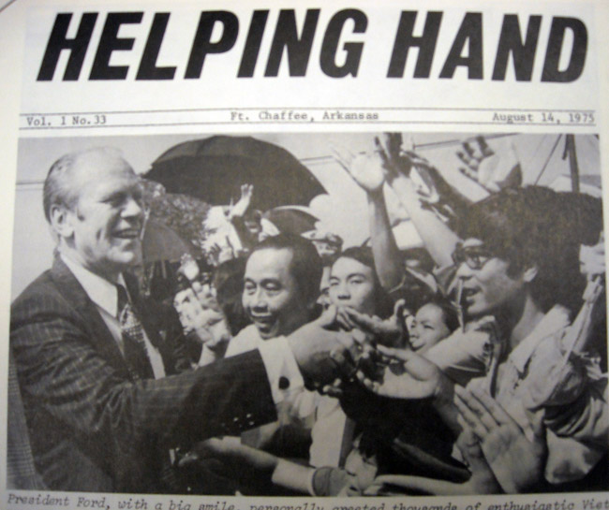
Notes:
Fact 10
The presence of the Hmong people in Arkansas stems from the evacuation of allied groups by the U.S. government at the end of the Vietnam War.

Slide 18
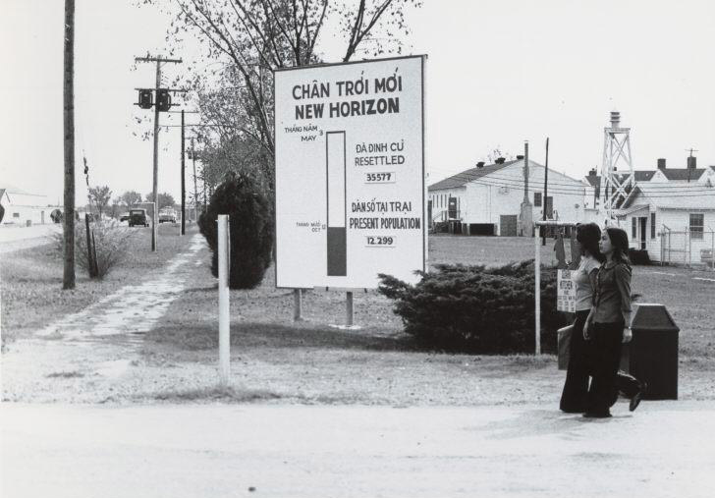
Notes:
Fact 10
When the US evacuated in 1975, it left a wide segment of the Indochinese population who had assisted the American military and political effort.

Slide 19
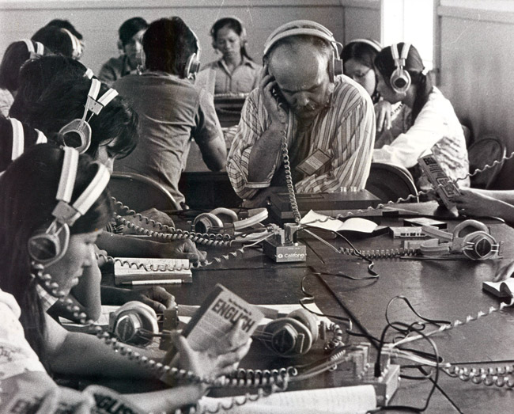
Notes:
Fact 10
The 1975 Indochina Migration and Refugee Assistance Act was one congressional response. At Fort Chaffee, the project was referred to as “Operation New Life.”

Slide 20
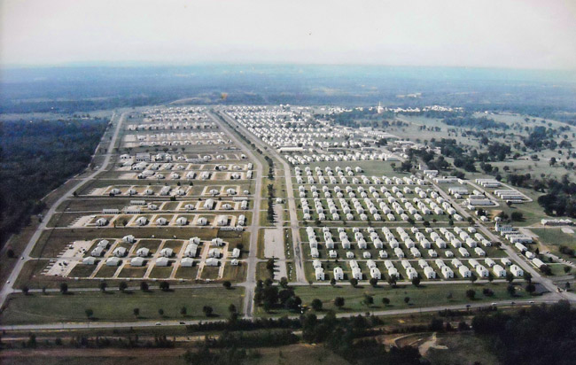
Notes:
Fact 10
By the last day of the program 50,809 refugees had been processed through Fort Chaffee. A small fraction made their home in Fort Smith, though most were relocated to other states.
Only a small group of Hmong were among the first group of Asian refugees to arrive in the US, but beginning in 1979 and continuing until the mid-1990s, more than 100,000 were admitted to the United States.

Slide 21
Notes:
Fact 10
Several Hmong from across the country came to Arkansas in 2004 when they learned that Tyson Foods, a chicken-processing company, was offering land and poultry farms.

Slide 22
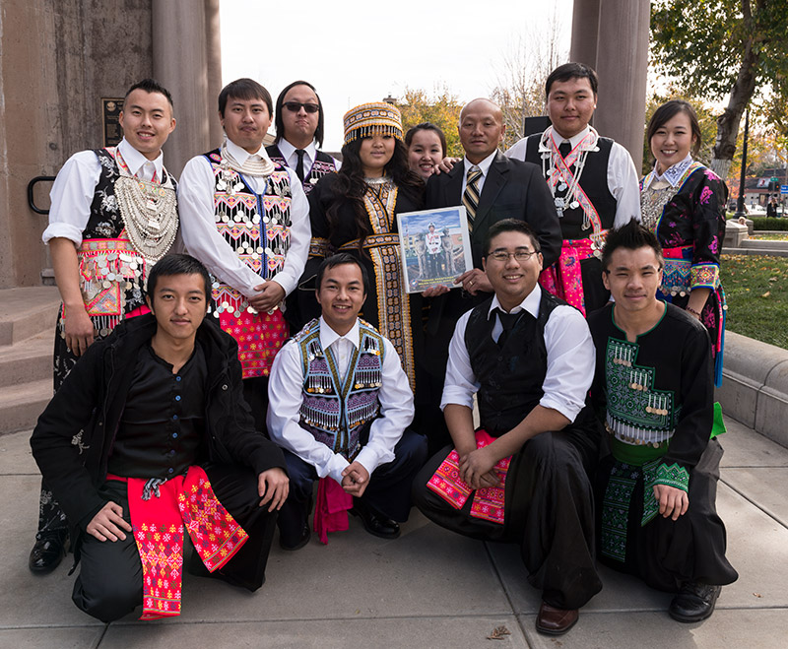
Notes:
Fact 10
Here's a group of Hmong people wearing traditional dress.

Slide 23
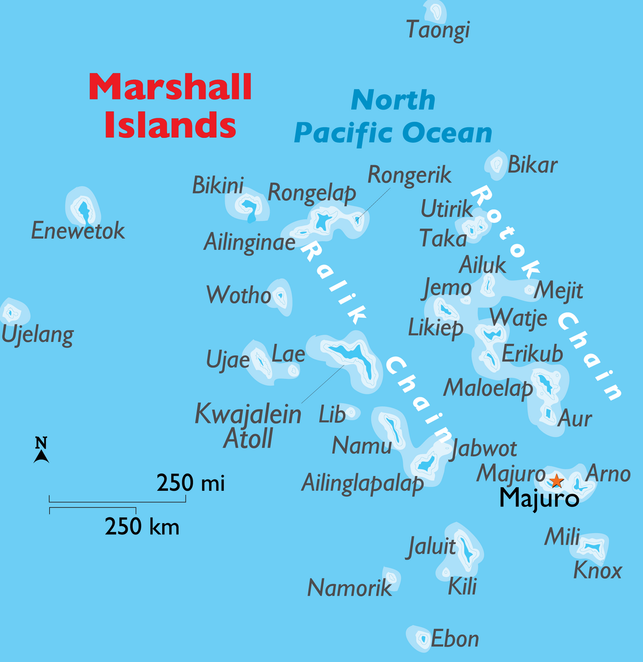
Notes:
Fact 11
Marshallese people, a.k.a. Marshall Islanders, have been migrating from their North Pacific archipelago to the Ozarks since the 1980s.

Slide 24
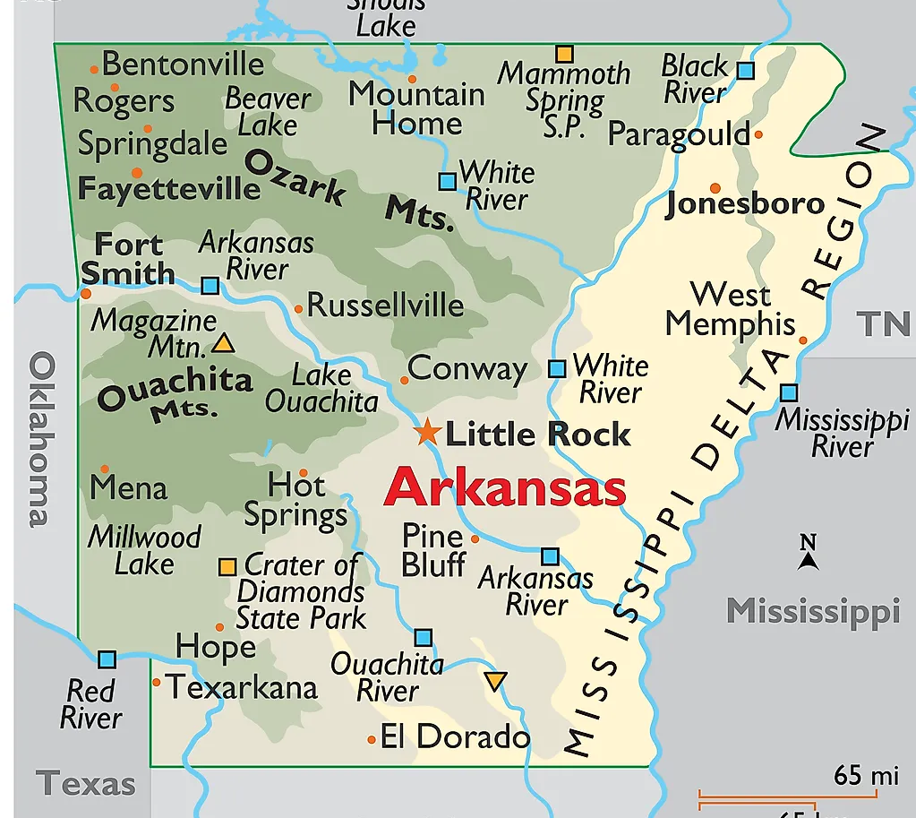
Notes:
Fact 11
The second-largest US continental population of Marshallese is concentrated in Springdale (Washington and Benton Counties).

Slide 25
Notes:
Fact 11
Most Marshallese in Arkansas labor in poultry slaughterhouses but are increasingly finding jobs in other sectors, professions, and self-established businesses.

Slide 26
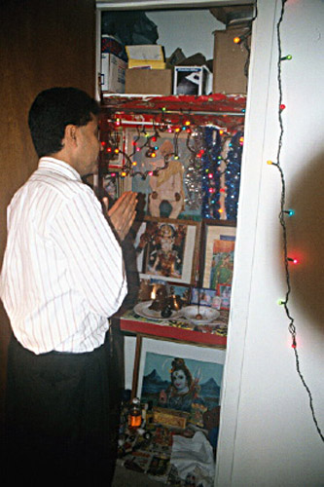
Notes:
Fact 12
Another group that deserves mention is the Hindu religion. An estimated 15,000 Hindus live in Arkansas. Hinduism is regarded as the world’s oldest living religion, and it is the third largest in the world. Currently, there are about one billion followers, ninety percent of whom live in India, where the religion originated.
Although isolated Hindu families have lived in the US since the beginning of the twentieth century, large numbers of Indians started arriving in the United States in the late 1960s. Many Hindus in Arkansas are physicians, engineers, computer professionals, business professionals, or hotel/motel operators.

Slide 27
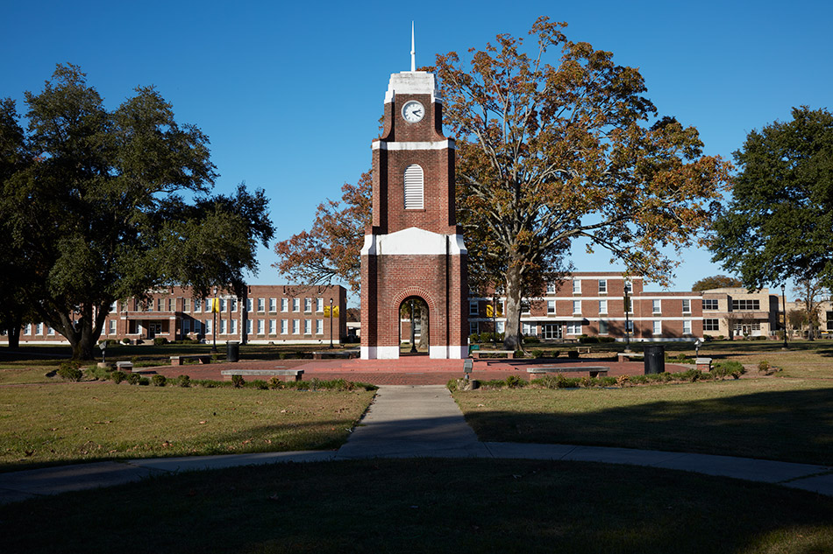
Notes:
Fact 12
Among the early arrivals in Arkansas were Dr. Haridas Mazumdar and his wife, Amu Mazumdar, who arrived in the mid-1950s. Mazumdar was dean of the College of Arts and Science at what is now the University of Arkansas at Pine Bluff (UAPB),

Slide 28
Notes:
Fact 12
and his wife was a professor of social work at the University of Arkansas at Little Rock (UA Little Rock).

Slide 29
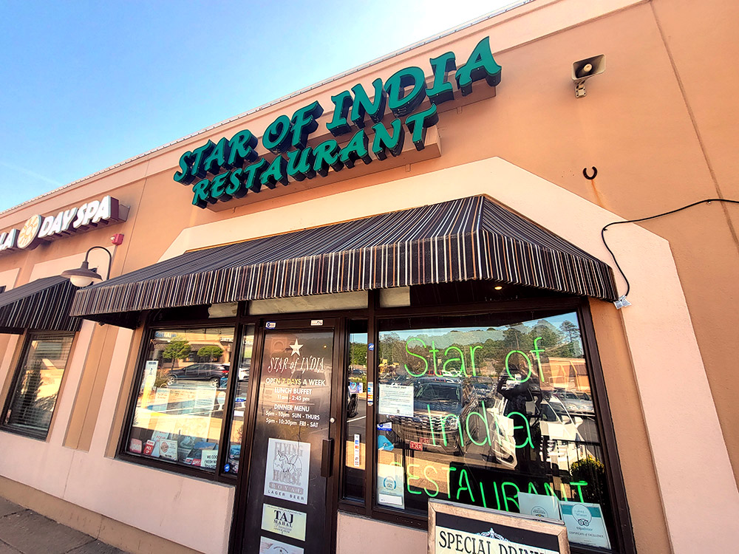
Notes:
Fact 13
One popular Indian restaurant in Little Rock is Star of India. This award-winning establishment has been around since 1993 and is said to have been the state's first Indian restaurant. Chef and owner Sami Lal greets patrons with the charming salutation "welcome home."

Slide 30
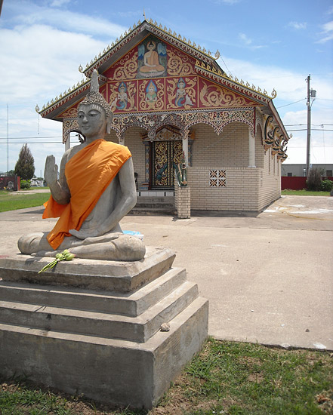
Notes:
Fact 14
Buddhists in Arkansas are represented by ethnic immigrants who bring to the state the religious practices of their homelands as well as native Arkansans who have turned to Buddhism for their spiritual needs. Though less than one percent of the population of Arkansas, Buddhists in the state have established temples testifying to their presence, in addition to meeting in a variety of formal and informal groups.

Slide 31
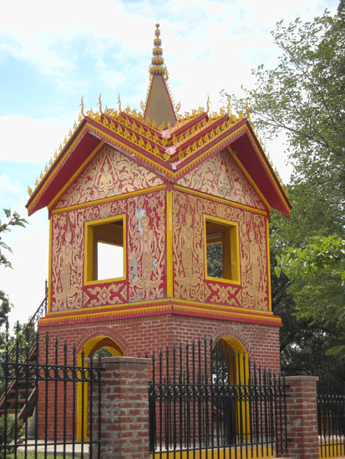
Notes:
Fact 14
There are at least two Buddhist temples in Arkansas serving primarily Laotian immigrant communities: Wat Buddha Samakitham in Fort Smith and Wat Lao Thepnimith Xaimongkoon in Springdale. Wat Buddha Samakitham, the largest in the state, was founded in 1989. By 2001, it had ten permanent monks and occupied six acres of land.

Slide 32
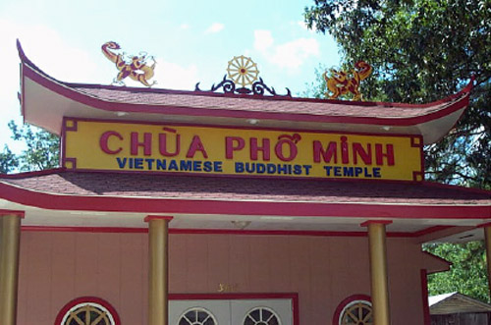
Notes:
Fact 14
Fort Smith also became home to two Vietnamese Buddhist temples, the foremost of which is Chùa Phô Minh. Fort Smith temple Wat Lao Buddharam was destroyed by fire on March 5, 2015. In 2005, the Chùa Bat Nha temple in Bauxite, which serves a predominately Vietnamese community, opened.

Slide 33
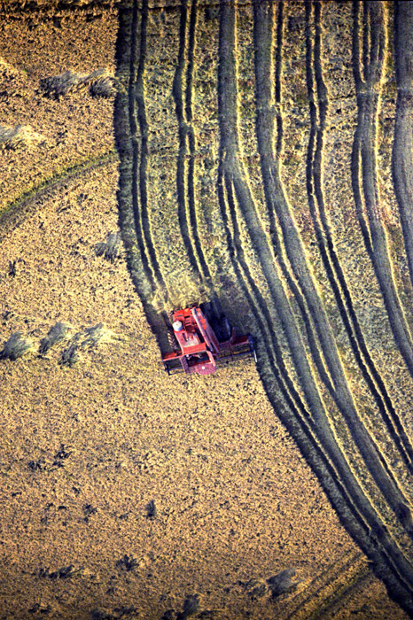
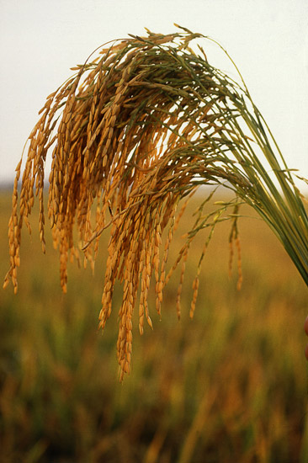
Notes:
Fact 15
And last but not least...
Did you know that rice is Arkansas’s leading agricultural product? Domesticated rice (Oryza sativa) is not native to North America. It has been cultivated in central Asia for up to 6,500 years, and its use gradually spread to eastern and western Asia, the Mediterranean basin, and Africa. Roughly 40,000 official varieties of rice are recognized, but they usually are sorted into three categories: short-grain, medium-grain, and long-grain. While most rice is consumed as a grain, rice is also an ingredient in many other products, including pet food and beer.
Rice is so popular in Arkansas that we even have an Arkansas Rice Festival, held during the second weekend of October in Weiner (Poinsett County). It was started in 1976 to promote the consumption of Arkansas rice and to celebrate Arkansas’s status as the number-one rice-producing state in the nation.

Slide 34
QUESTIONS
Notes:
This is just the tip of the iceberg. The Encyclopedia of Arkansas is a rabbit hole I encourage you to jump down. No matter what you are interested, Arkansas has it and the EOA is where you can start looking.
[QR Code goes to EOA home page]

